Slide 1
Improving Driver Experience
Perspective of
a production facility
Bruno De Clerck | Transportation & Fleet Supervisor
Luc Haesaerts | Haesaerts Intermodal n.v.
November 17th, 2022

Slide 2
About Chevron Phillips Chemical

Slide 3
Products that perform, People who care
We responsibly manufacture chemicals and polymers the world needs, provide enriching careers and create shareholder value because we care about each other, our customers and our communities.
We responsibly manufacture chemical products that are essential to the manufacturing of over 70,000 consumer and industrial products.
Our solutions include olefins, aromatics, drilling specialties, normal alpha olefins, polyalphaolefins, polyethylene and specialty chemicals.
CPChem in numbers:
+$17 billion in assets
4760 employees
Expanded production from 19 billion in 2000 to 36 billion
“This presentation may contain confidential information of Chevron Phillips Chemical Company (“CPChem”) . Any copy or use of the information contained therein without CPChem prior authorization is prohibited”.

Slide 4
“Performance by design. Caring by choice.(TM)”
Safety
As a matter of policy, we strive to manufacture, handle, transport and dispose of our chemical products safely, securely and responsibly.
ICARE
Blending the unique skills and talents of a diverse workforce creates a superior chemical company. ICARE stands for Inclusion, Cooperation, Accountability, Respect, Everyday.
Suppliers
The supplier Principles of Conduct apply to all of our suppliers and business partners and we encourage them to share in our commitment to socially responsible and sustainable operations
Community
Since inception, we have invested more than $32 million in the communities where we operate
Our primary focus areas are:
Protect human rights
Improve quality of life
Increase economic prosperity
“This presentation may contain confidential information of Chevron Phillips Chemical Company (“CPChem”) . Any copy or use of the information contained therein without CPChem prior authorization is prohibited”.

Slide 5
“Performance by design. Caring by choice.(TM)”
Safety
As a matter of policy, we strive to manufacture, handle, transport and dispose of our chemical products safely, securely and responsibly.
ICARE
Blending the unique skills and talents of a diverse workforce creates a superior chemical company. ICARE stands for Inclusion, Cooperation, Accountability, Respect, Everyday.
Suppliers
The supplier Principles of Conduct apply to all of our suppliers end business partners and we encourage them to share in our commitment to socially responsible and sustainable operations
Community
Since inception, we have invested more than $32 million in the communities where we operate
Our primary focus areas are:
Protect human rights
Improve quality of life
Increase economic prosperity
“This presentation may contain confidential information of Chevron Phillips Chemical Company (“CPChem”) . Any copy or use of the information contained therein without CPChem prior authorization is prohibited”.

Slide 6
How does CPChem contribute ?

Slide 7
On site activities of the driver
Video showing arrival, security check, administration, in&out, driver area
Drop & Swap
Short gate-to-gate throughput
Additional investment rolling equipment
Recent investment in driver facilities
CPChem operators taking care of all loading/unloading operators
“This presentation may contain confidential information of Chevron Phillips Chemical Company (“CPChem”) . Any copy or use of the information contained therein without CPChem prior authorization is prohibited”.

Slide 8
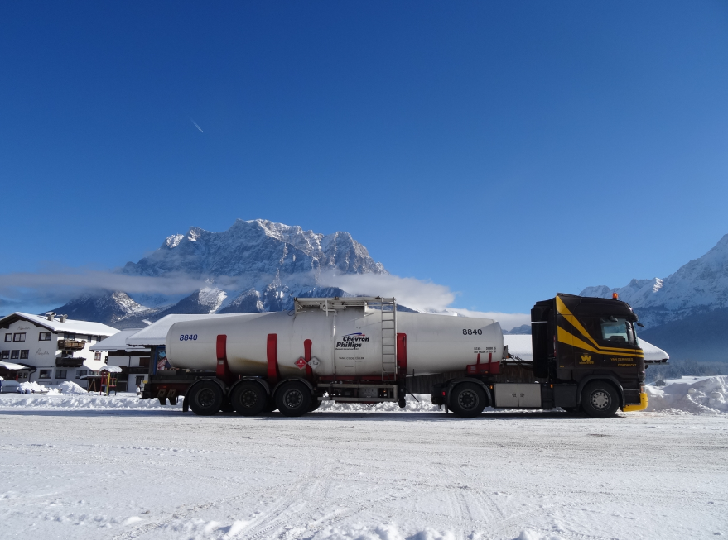
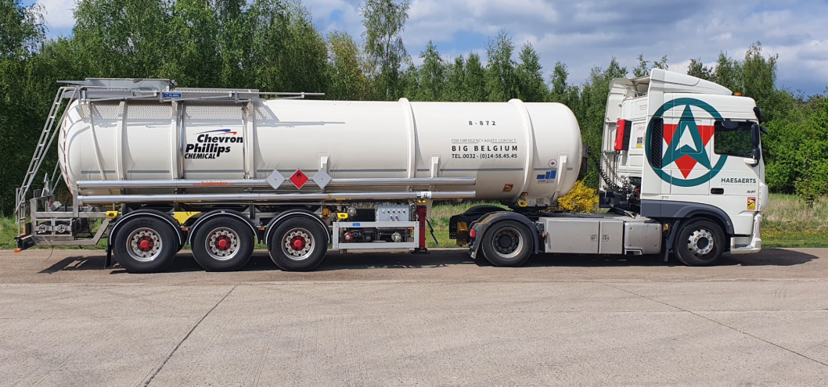
CPChem driver training day
Dedicated training for drivers on CPChem equipment
Transport Specifications as a manual on CPChem processes, products, loading points
Level playing field all carriers
Direct communication
Digital & physical “book” for events at unloading / equipment
Dedicated CPChem training vehicle
Internal training
Carrier training
Fire department training
“This presentation may contain confidential information of Chevron Phillips Chemical Company (“CPChem”) . Any copy or use of the information contained therein without CPChem prior authorization is prohibited”.

Slide 9
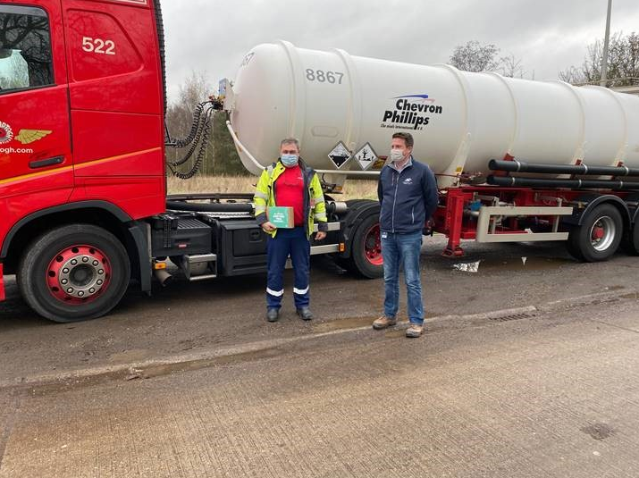
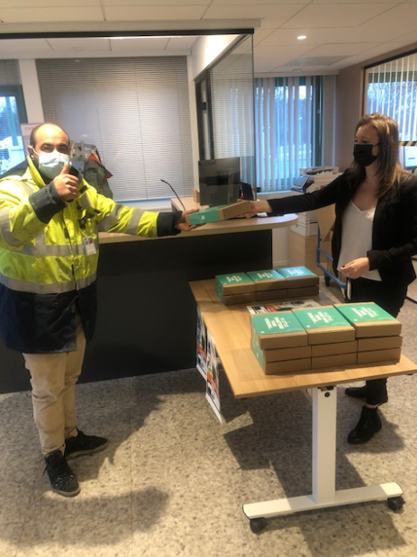
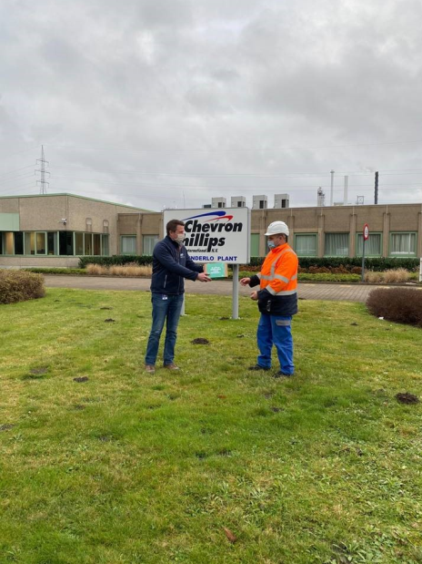
Day of the truck driver
2021, 9th dec
Handed out appreciation packages with healthy snacks and drinks on both our production sites
EA region General Manager Antoine Janssens personally came and interacted with the drivers
December 8th, 2022
“This presentation may contain confidential information of Chevron Phillips Chemical Company (“CPChem”) . Any copy or use of the information contained therein without CPChem prior authorization is prohibited”.

Slide 10
What’s next?

Slide 11
What’s next?
Revalue profession of the chemical driver
Create environments where drivers feel appreciated
Industry wide effort
Manufacturer, Transporter, Customer
“This presentation may contain confidential information of Chevron Phillips Chemical Company (“CPChem”) . Any copy or use of the information contained therein without CPChem prior authorization is prohibited”.

