Slide 1
Hydrogen mobility in the
heavy commercial vehicle sector
November 2022 Daniel Keller @ECTA Annual Meeting in Düsseldorf

Slide 2
Km driven in Switzerland and counting
‘
‘
5
1
4
4
5
0
6
Kilometer drove in CH with 47 trucks since October 7th, 2020

Slide 3
Battery vs. Fuel cell from an efficiency perspective
Truck: Hydrogen is the future in heavy-duty trucking
BEV Truck
Hydrogen Truck
efficiency
efficiency
Range: 400 km, charging time 1.5 h
_{(0.5 MW needed)}
Range: 400 km, refueling: <15 min.

Slide 4
350 bar vs. 700 bar
350 bar 700 bar
Tank volume 31kg +40%
Range 400 km +40%
Price Hydrogen @HRS base + 1.50 Euro/kg
Extra cost per 100km base + 12 Euro/100km
Refueling time Ø 15min Ø 15min
Technical complexity normal higher
Hydrogen production 65kWh 65kWh

Slide 5
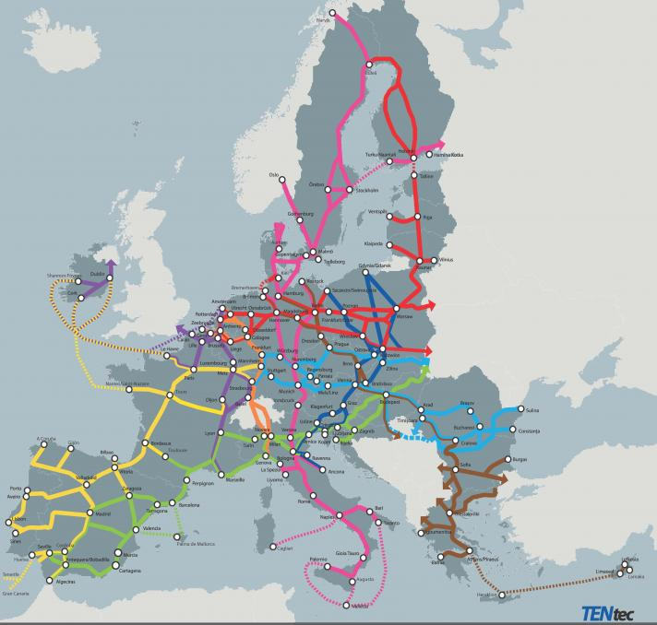
Hydrogen availability is key to success
There are some initiatives to make hydrogen mobility interesting for long-distance traffic as well.
Progress is being made, but it varies significantly from region to region.

Slide 6
Logical steps to lower TCO
The public is getting used to hydrogen
More trucks on the streets = more workshops
Higher quantities will lower spare parts prices
The road to success
More OEM in the market will lower the truck prices
Tight HRS Network
Hydrogen transported in pipelines
Green offshore production sites
Hydrogen Prices at the HRS need to be around 5 Euros/kg

Slide 7
What is Hyundai doing?

Slide 8
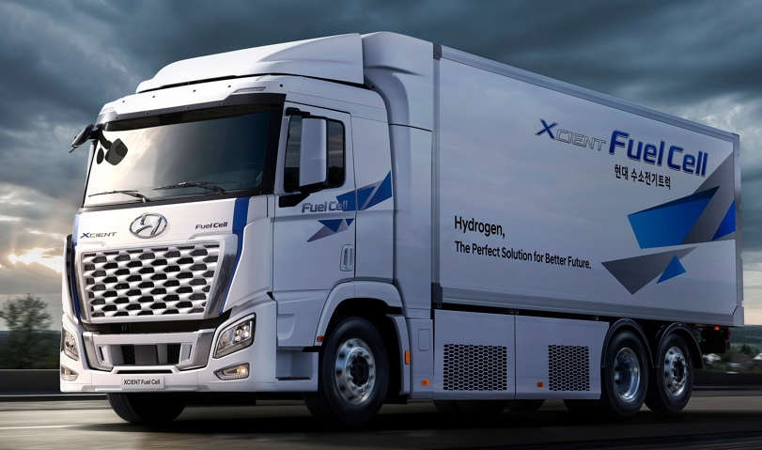
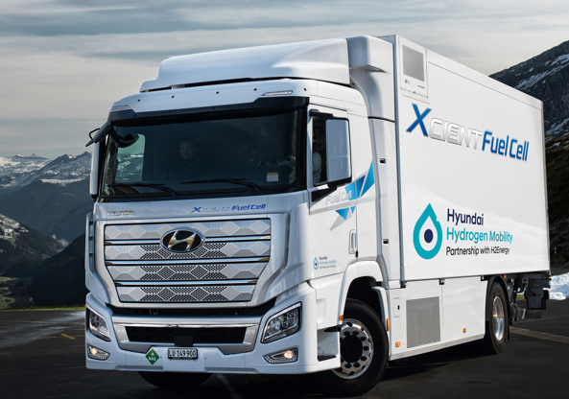
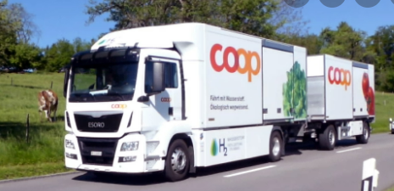
The development of the truck
2016
2019/2020
2022
First road test
Proof of concept
October 7t, 2020, launch in Switzerland
Proof of concept for truck and HRS
More than 25k refuelings in CH
Setting up an H2 ecosystem
47 trucks on the road plus 5 Mio. km
Facelift and technical changes (E-Motor, Tanksystem, etc.)
More types of upfits available
Truck for the world market
1 LKW - 100’000 Kilometer
Prototype
Pre-Massprodution
Massproduction
Notes:
Nun legten wir den Fokus in den vergangenen Monaten auf
Rollout Deutschland
Per April haben wir Hyundai Hydrogen Mobility Germany gegründet
Europa Start (grosse im Hintergrund laufende Aufwände
Optimierungen und Test mit neuem Tanksystem
Wir bieten ab diesem jahr ein in Serie gefertigtes neu aufgebautes Wasserstoff Fahrzeug an.
Von der ersten Schraube bis zum letzten Verschalungsteil oder Pinselstrich – jeder MA am Band arbeitet in seiner Sequenz ausschliesslich an Xcients
Das für Europa aber neu auch für die USA, Neuseeland und den Heimmarkt in Korea

Slide 9
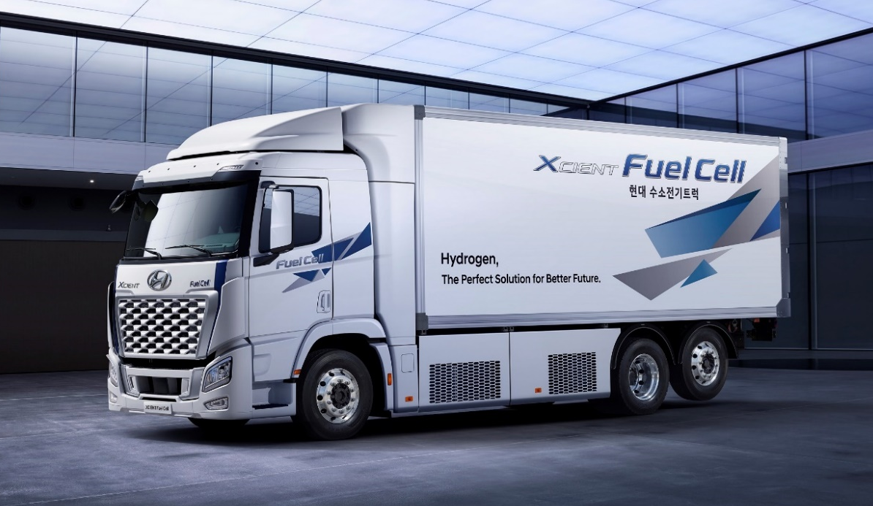
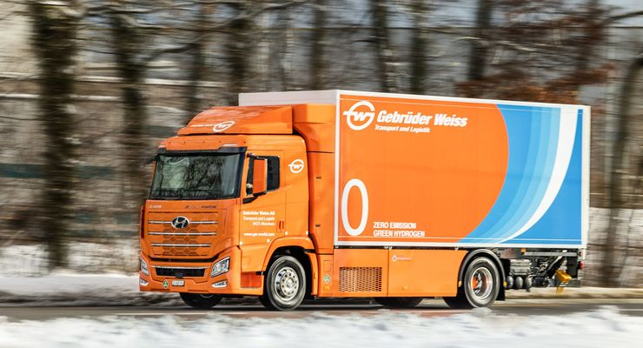
Available Trucks for the European market
The model for the EU market with high payload
Distribution vehicle for light goods
GCW: 36 t
19 t GVW + 17 t Trailer
GCW: 42 t
27 t GVW + 15 t Trailer
Payload solo approx. 12 t
ADR for general cargo(no EX II/III, AT, FL)
72 kWh Battery
2 Fuell Cells with each 90kW
31kg Tank system – 350 bar
E-Motor with 350 kW

Slide 10
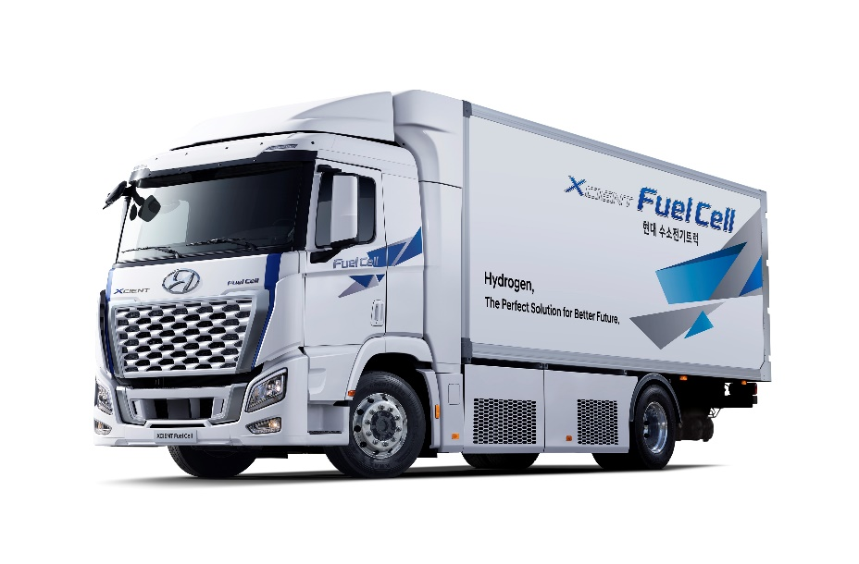
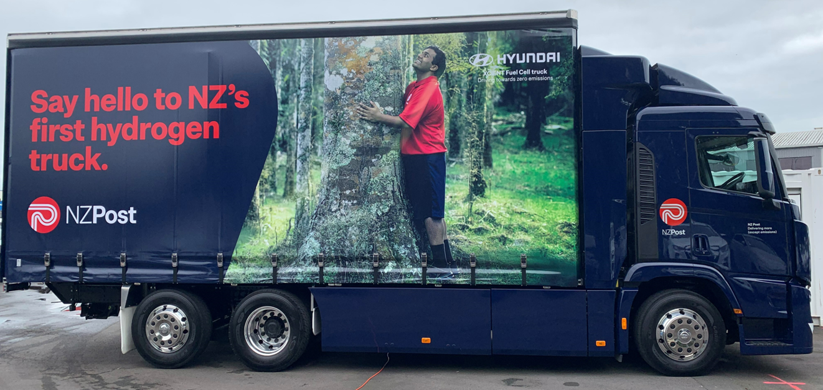
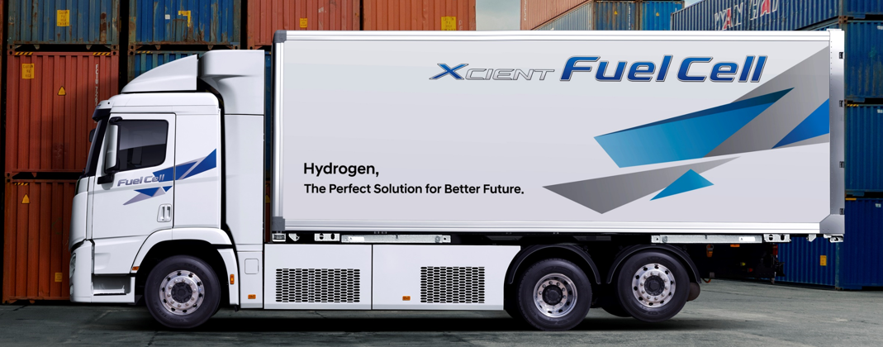
Available upfit configurations
Box upfit
Cooled and uncooled
Tarpaulin upfit
Swap Body upfit with Standalone tank system
From Q1/2023

Slide 11
Rollout Germany
German Founding Call #2
2022 – 2023
> 150 quotations have been sent out for a 3 digit number of trucks in Germany
In operation in/after Q4/2023
German Founding Call #1
2021 – 2022
27 trucks sold
3 bodybuilders are certified
Ten 6x2 handed over to bodybuilders to be built up (box) 15.09.2022
5 aftersales Partners have been trained and qualified 23.09.2022
In operation Q1 / 2023

Slide 12
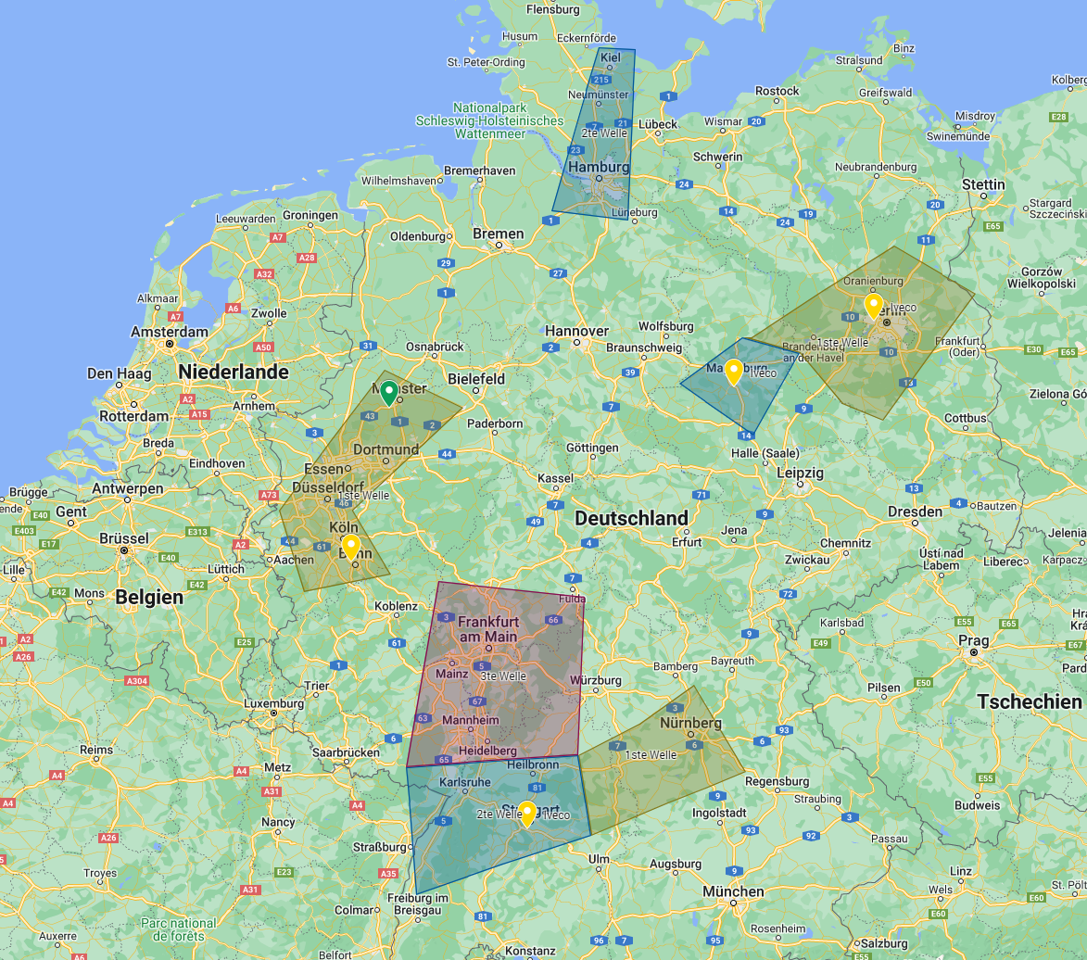
Service Points in Germany (January 2023)
Workshops opening where trucks are operated
6 Workshops defined and trained, more to come in 2023
Hyundai Hydrogen Mobility Germany operational
More countries to follow when quantities are in the market

Slide 13
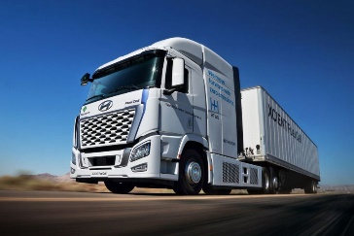
The future
Standalone Tank
Swap body
More wheelbase options (longer)
Stronger PTO-Connection
Tractor
2022 2023 2024 2025 2026
?
?
Facelift
Tarpaulin
Weight reduction
Higher payload
Technical improvements
Efficiency improvements

Slide 14
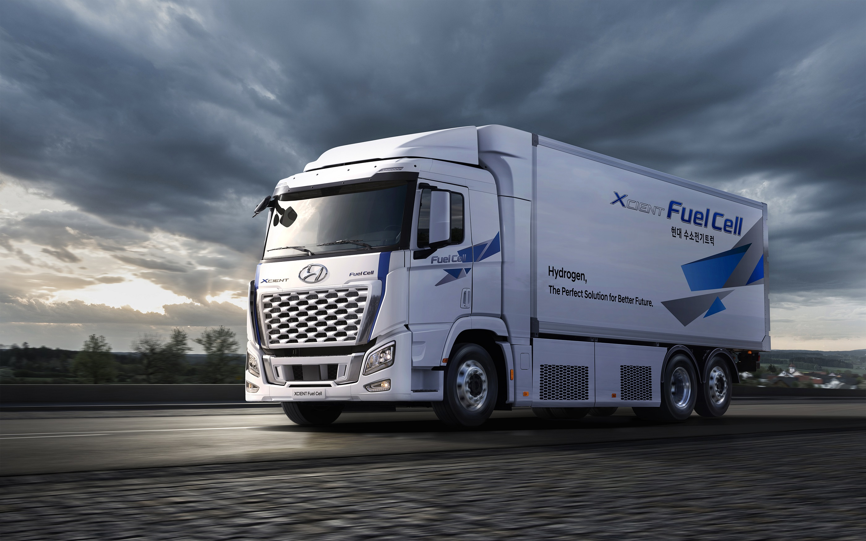
Daniel Keller
COO
Hyundai Hydrogen Mobility AG
Hohlstrasse 186
CH-8004 Zürich
Daniel.Keller@HyundaiHM.com

