Slide 1
Dynamic Charging Reaching goals in time

Slide 2
Assessing technologies for climate friendly trucking involves several aspects
Criteria relevant for scaling up technologies and thus achieving the climate targets
Operational range
Time to market
Scalability & resource efficiency
Energy efficiency
Total cost of ownership
Flexibility
CO₂ abatement cost

Slide 3
#operationalrange

Slide 4
Range is especially important for long-haul operations
Long range happens almost exclusively on highways
100%
Journeys of 500 km or more are almost entirely on motorways (>80%)
80%
RF
60%
Mean motorway share
40%
FCEV
20%
BEV
0%
0
500
1,000
1,500
Daily mileage [km]
BEV: Battery electric vehicle | FCEV: Fuel cell electric vehicles | RF: Renewable fuel (for combustion engine)
Source: Fraunhofer feasibility study of catenary trucking, on behalf of the German Transport Ministry, page 131

Slide 5
#timetomarket

Slide 6
Reaching political goals requires around 70% of truck sales in 2030 being zero emission
Share of new reg. semi-trucks [%]
Analyses show that reaching key political goals (e.g., Paris Agreement, EU Fit-for-55, Germany’s national goal: 1/3 mileage using electricity) will require a 70% share of new semi-truck sales to be electrified zero emission trucks in 2030.
Those sales figures will only be met if sufficient infrastructure to power those trucks can be put in place by then.
Diesel
Zero emission vehicles

Slide 7
Overhead contact lines offers the most mature technical solution for long-haul heavy road freight
Time to market for each technology in long-haul trucking
OCL
Overhead Contact Line Ready for roll-out
RF
Renewable Fuel Initial efuel production facility in operation
BEV
Battery Electric Vehicle Standardization of Megawatt charger planned to be completed
FCEV
Fuel cell Electric Vehicle Announcement for start of serial production
2021
2022
2023
2024
2025
2026
2027

Slide 8
#scalability

Slide 9
Ramping up supply chains for catenary solution looks far less challenging than the alternatives
Copper
Lithium
Cobalt
Mt
80
3,200
Kt
400
60
2,400
300
Kt of lithium carbonate equivalent
40
1,600
200
20
800
100
0
0
0
2020
2022
2024
2026
2028
2030
2020
2022
2024
2026
2028
2030
2020
2022
2024
2026
2028
2030
Production:
Under construction
Operating
Primary demand:
Stated Policies Scenario (STEPS)
Sustainable Development Scenario (SDS)
Source: IEA The Role of Critical Minerals in Clean Energy Transitions (2021) page 119 | https://www.iea.org/reports/the-role-of-critical-minerals-in-clean-energy-transitions

Slide 10
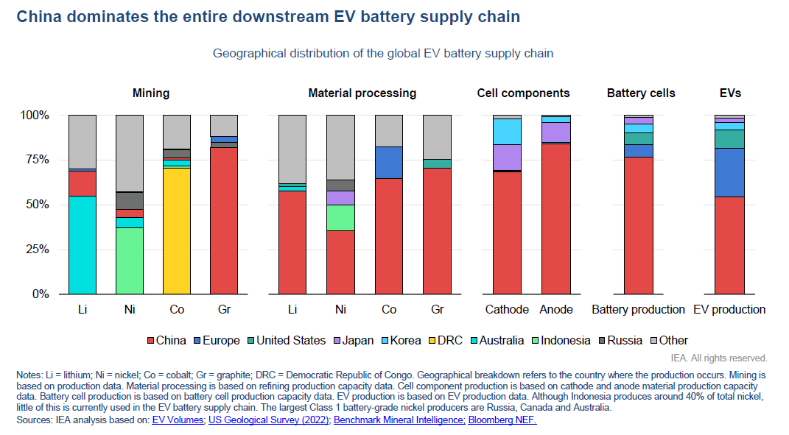
IEA: China dominates the entire downstream EV battery supply chain

Slide 11
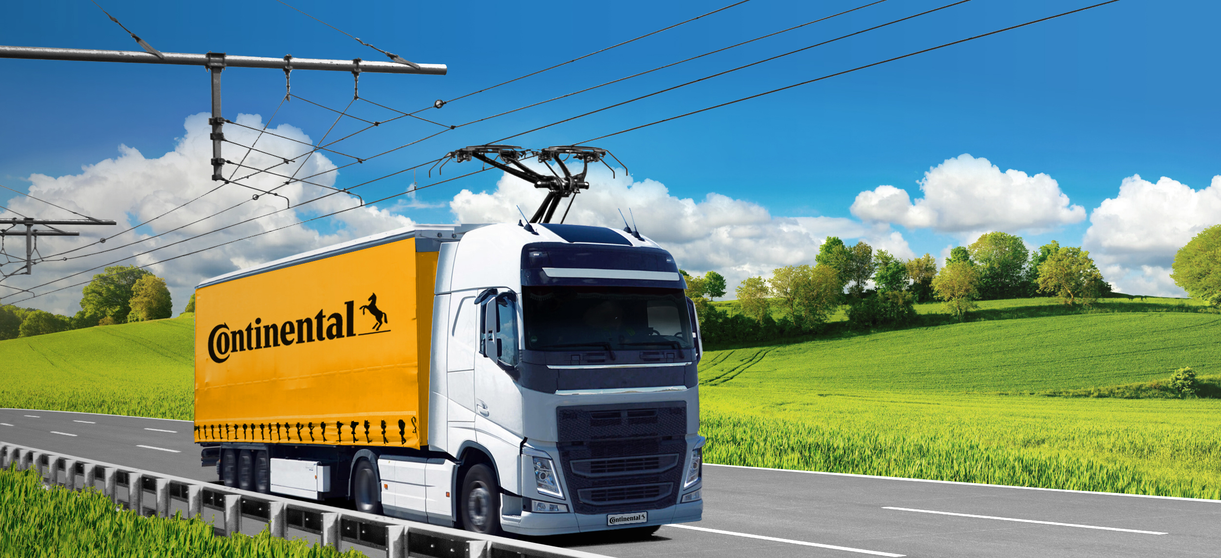
Role out of technology Based on cooperation across industries and development of open standards
EN50119 incl. informative annex C – OCL for electric trucks
In the April 2020 update an Annex (informative) on infrastructure requirements for overhead contact lines for electric trucks on roads was already integrated.
TC9x – Interaction between pantograph and OCL on electrified roads
CENELEC working group (WG27) finalizing and reviewing a technical specification (TS) as initial step of a technical standard. TS expected in 6-9 months.
https://www.continental.com/en/press/press-releases/20210729-ces-siemens-ehighway/

Slide 12
International interest in dynamic charging is growing, e.g., in Europe Enabling zero emission trucking on core motorways, example countries
1. Nordics
SE: National Transport Plan 2022 – 2034 includes planning for 2,400 km electrified motorways
SE: Ca. 20 km pilot between national rail hub and nearby logistic centers being procured
DK: Parliament approved €400 k study on overhead catenary (OCL) corridor to Germany
NO: Public Road Administration study finds dynamic charging for trucks a cost-effective solution
2. UK
Gvmt. funded £2 m feasibility study on ca. 20 km catenary pilot with 50 – 150 trucks
Study finds catenary “most energy-efficient and cost-effective solution”, see also podcast
1
1
1
3. BeNeLux
NL: Study finds most economical. Alignment with neighbors is very important
BE: Study finds a very strong business case for overhead catenary
2
3
3
4
5
4
4
4. Central Europe
AT: Study “Energy Roads” ongoing, with involvement of neighbors CZ and SK
HU: Transport minster keen on implementing pilot project. Joint corridor study with AT & DE starting
PL: Local government project proposal for catenary route in southern Poland
5
5
5. Mediterranean
FR: Three Ministry-lead working groups on ERS: catenary is the cheapest solution for trucks
IT: Ministry strategy for trucks focus on electrification, incl. use of catenary
ES: Study by ECF finds TCO for overhead catenary already lower than ICE by 2025
Catenary solution: Demo/field trial realized or in preparation
Study with regard to catenary solution for HDV exists or under preparation
Interest in catenary solution exists

Slide 13
#energyefficiency

Slide 14
Direct electricity offers the most efficient way to use renewable energy
Energy efficiency is key:
Fuel cost large part of TCO
Renewable energy still limited in availability
Large difference in energy efficiency impacts expected GHG-reductions and fuel cost savings
Adding losses in transport of fuel makes the difference even starker, especially for H2

Slide 15
#costofownership

Slide 16
Cost of energy is by far the most important factor in the total cost picture
Overall costs of carbon neutral road freight transport until 2050: energy costs of particular importance
Case study
Decarbonization of German long-haul freight transport
200
175
150
125
Accumulated costs (2020 – 2050) in € bn (compared to fossil fuels)
100
75
50
25
0
Energy infrastructure
Vehicle
Energy supply
Total cost
Source: https://www.plattform-zukunft-mobilitaet.de/wp-content/uploads/2020/12/NPM_AG1_Werkstattbericht_Nfz.pdf
High cost scenario
Low cost scenario
RF
OCL
FCEV (PtG)

Slide 17
NPM also sees electric solutions as near cost parity with diesel, far ahead of indirect alternatives in 2030
Where energy efficiency differs greatly the resulting energy costs also dominate the TCO calculation, e.g., almost half the TCO for FCEV is due to energy costs
Total Cost of Ownership Semi Truck 40t (reference)
125,000
+94%
100,000
Infrastructure purchase
Where energy efficiency is high, the cost of the vehicle dominate the TCO, e.g., almost half the TCO for a BEV is due to the purchase price
Costs of days lost
75,000
+23%
Maintenance & repair costs
+5%
AdBlue costs
50,000
Energy costs
Truck for OCL with hybrid drive train slightly higher purchase price than diesel truck. However, a BEV truck for OCL would save on the combustion engine and not need as large a battery, and could be cheaper than a comparable diesel truck (see ECF report)
Insurance costs
25,000
Purchase price annuity
0
Diesel truck 2030
BEV truck 2030
OCL truck 2030
FCEV truck 2030
€ 2020/a
Source: https://www.plattform-zukunft-mobilitaet.de/wp-content/uploads/2020/12/NPM_AG1_Werkstattbericht_Nfz.pdf

Slide 18
#flexibility

Slide 19
Decarbonization of heavy-duty trucks
Technology options for trucks
Key characteristics
Preferred use case
H₂
High range to mass ratio
Best for long range use case in which electrification is not economical
High operational cost (e.g., due to fuel price, efficiency)
Hydrogen fuel cell power
Technology eco-system proven with light duty vehicles
Best for decarbonized urban distribution use case
Limited range
Battery electric power
Available infrastructure, suitable to decarbonize existing fleet ^{1,2}
Best for existing fleet decarbonization use case
Limited availability of fuels
Hybrid with synthetic/bio-fuel
1 Assuming that a truck with hybrid-electric drive train is used | 2 Synthetic fuels require renewable energy for its production

Slide 20
Decarbonization of heavy-duty trucks will be possible with dynamic charging and an intelligent combination of drive train technologies
Technology options for trucks
Key characteristics
Preferred use case
All three drive train technologies and their business cases can be “boosted” by charging infrastructure such as “Overhead Contact Lines” (OCL) on major transit lines, similar to electric trains, reducing the cost per km.
H₂
High range to mass ratio
Best for long range use case in which electrification is not economical
High operational cost (e.g., due to fuel price, efficiency)
Hydrogen fuel cell power
Technology eco-system proven with light duty vehicles
Best for decarbonized urban distribution use case
Limited range
Battery electric power
Available infrastructure, suitable to decarbonize existing fleet ^{1,2}
Best for existing fleet decarbonization use case
Limited availability of fuels
Hybrid with synthetic/bio-fuel
1 Assuming that a truck with hybrid-electric drive train is used | 2 Synthetic fuels require renewable energy for its production

Slide 21
#CO₂abatementcost

Slide 22
NPM also sees electric solutions far ahead of indirect alternatives in 2030
Commercial vehicles >20t permissible total weight in 2030
Policy measures can influence the relative TCO in the short term, but the global picture for most economical solutions is better shown by looking at the full abatement cost of each solution.
Technologies where direct use of electricity is possible show an advantage of ca. 700 EUR per Tonne of CO₂.

Slide 23
In summary: Dynamic charging is an essential solution for climate protection in heavy road freight transport It…
… combines the benefits of electric railways with the flexibility of trucks
… makes it possible to reach the climate protection goals
… can be realized in an international context
… can quickly be rolled out
eHighway
… is flexibly compatible with other technologies and fuels
… changes the highway landscape
… is the most economical solution
Notes:
Image

Slide 24
Hasso Grünjes Head of eHighway
Siemens Mobility GmbH
SMO RI EL COC EH
Erlangen, Germany
Mobil: +49 (173) 277 8387 E-mail: hasso.gruenjes@siemens.com
www.siemens.com/ehighway
#eHighway

Slide 25
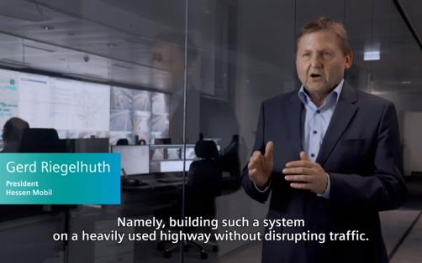
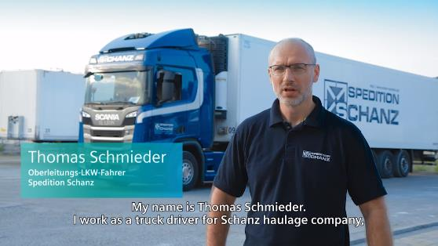
Proven in daily trucking operations on German motorways
Motorway owner’s experience of field trial
Experiences of an eHighway-truck driver
https://www.youtube.com/watch?v=gAUff-fz_MM&t=0s
https://www.youtube.com/watch?v=NHSofIc31rw

Slide 26
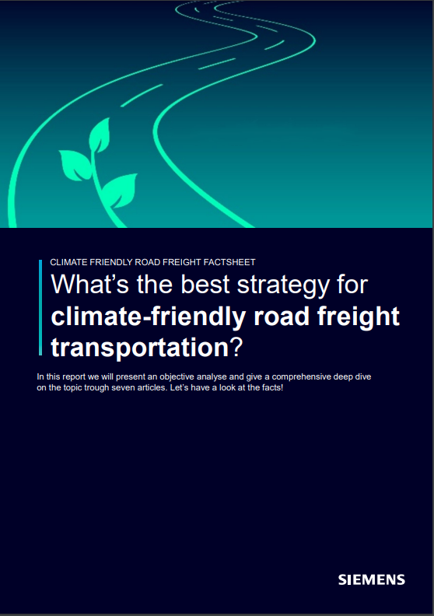
Factsheet for climate-friendly road freight
Available online

