Slide 1
BEV usage in Heavy Duty transports in a short to mid-term perspective
Volvo Trucks

Slide 2
Johan Mörck
Electric Driveline Strategy Director
Volvo Trucks

Slide 3
Volvo Trucks in numbers
global network of
assembled in
2,200
13
1
dealers
MILLION
countries
dealer and workshops
running population
130
123,000
countries
Volvo trucks delivered worldwide

Slide 4
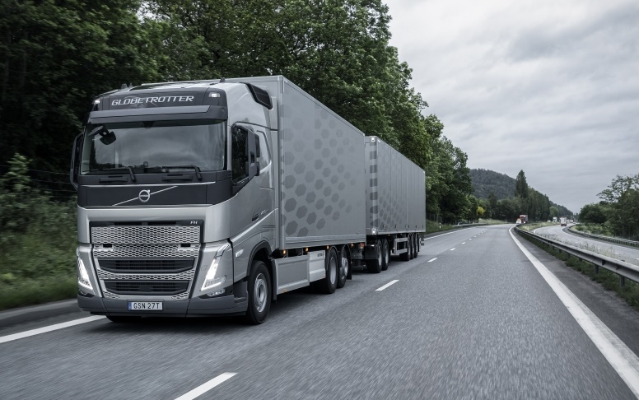
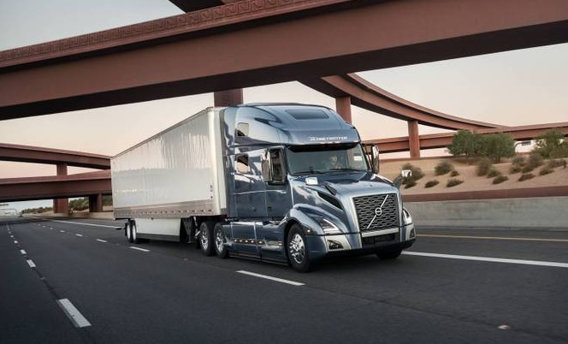
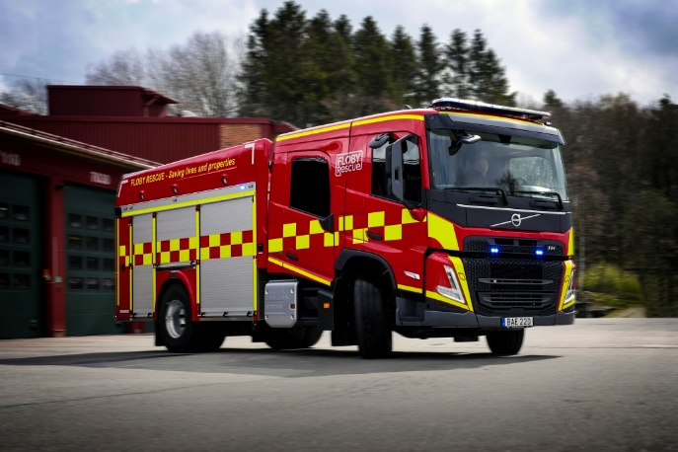
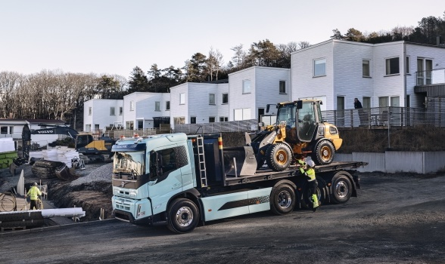
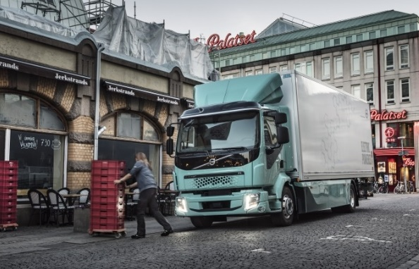
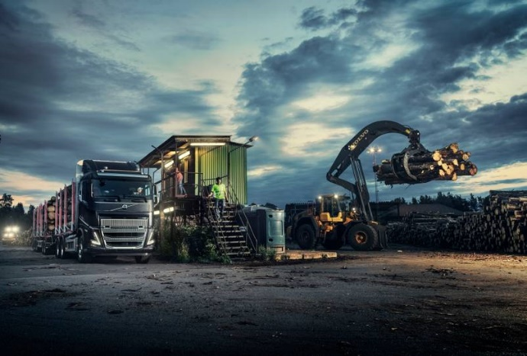
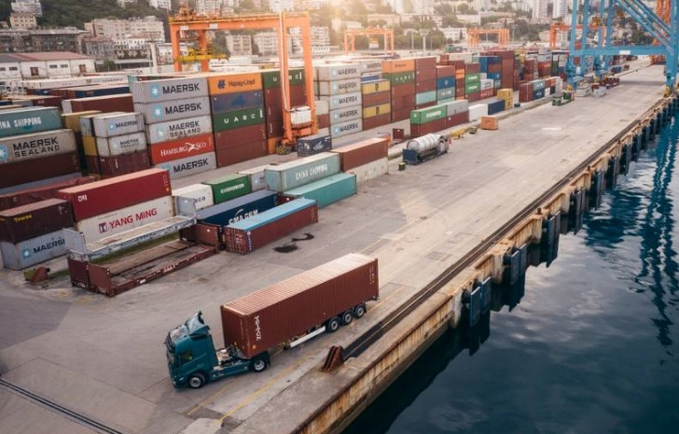
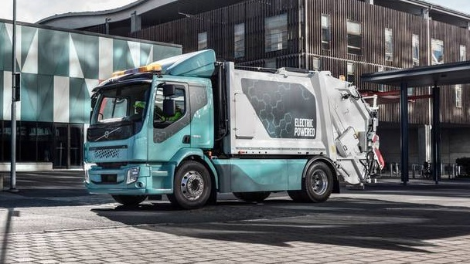
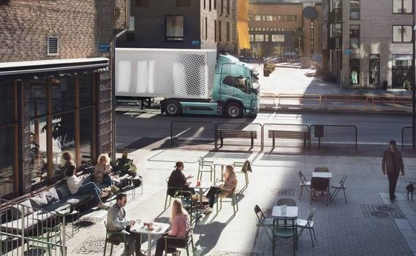
Trucks
the circulatory system of society

Slide 5
Part of the Problem – Part of the Solution
Greenhouse Gas Emissions EU 2018
Transportation
https://theicct.org/transport-could-burn-up-the-eus-entire-carbon-budget/

Slide 6
Towards fossil free transports
50%
100%
CO₂ reduction by
CO₂ reduction by
2030
2040
Volvo Trucks

Slide 7
Several technologies needed to meet target -50% CO₂
Energy Consumption
Heavy Construction
Heavy Haulage
Long Haul
Refuse
Construction
Regional Haul
City/Regional Distribution
Battery Electric
Fuel Cell (H2)
ICE (LNG/Diesel)
Yearly Mileage
Volvo Trucks

Slide 8
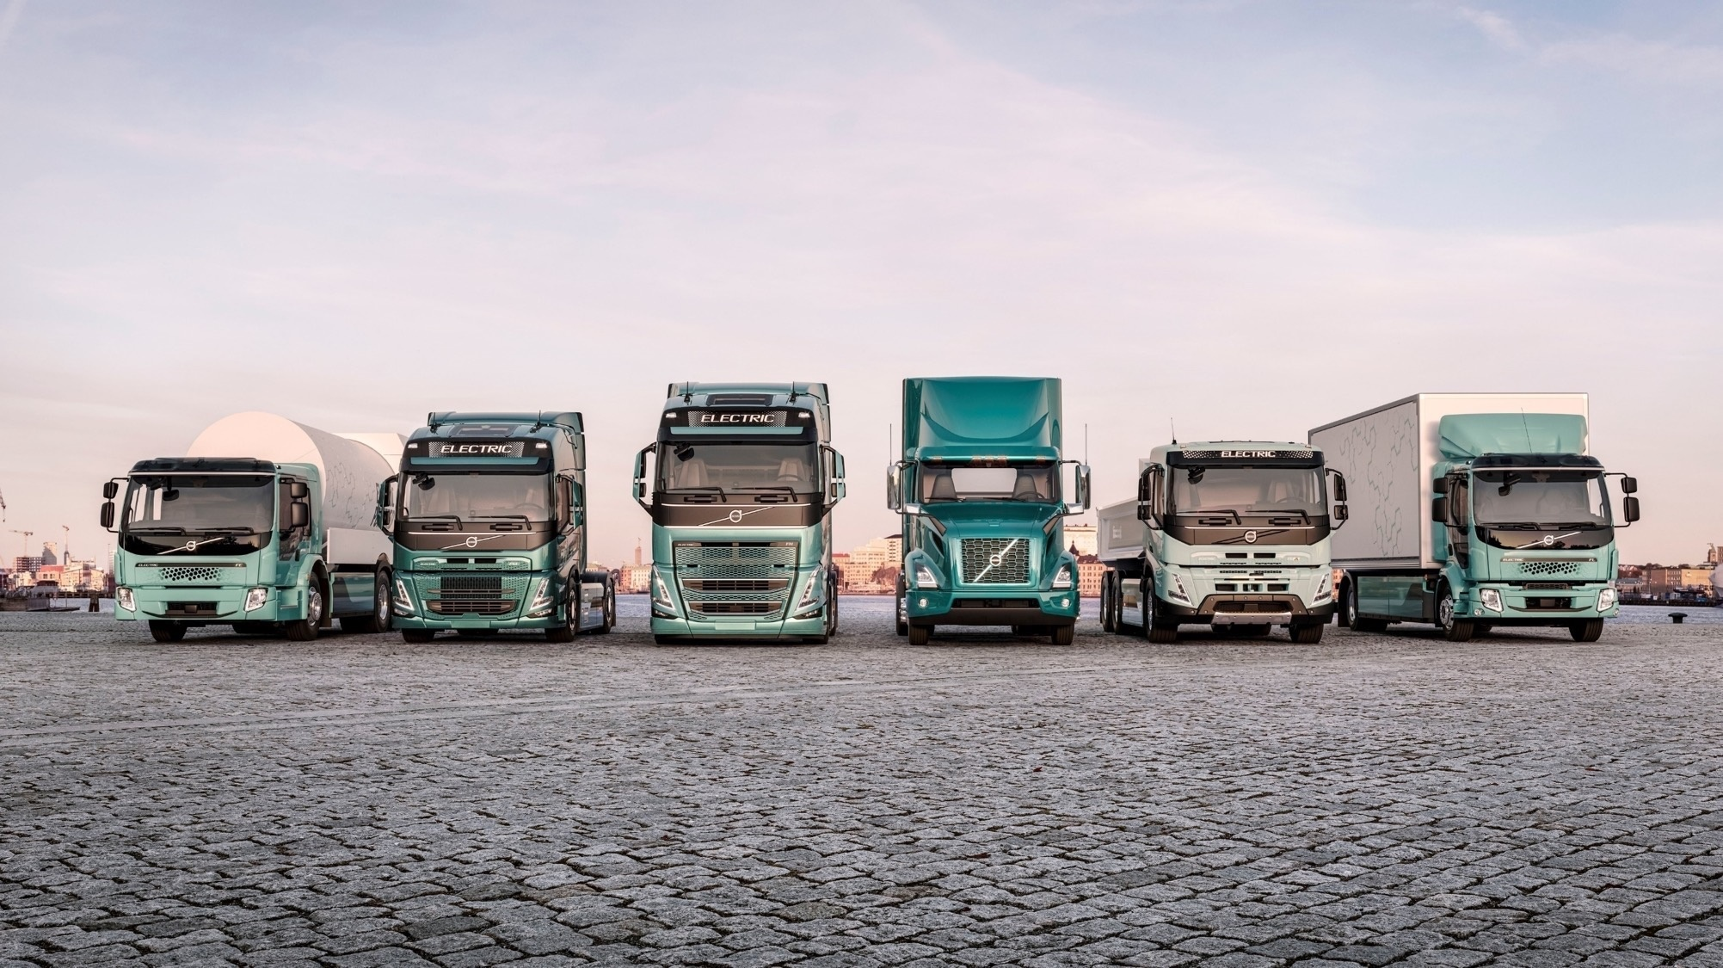
Our ElEctric Line Up
Volvo Trucks

Slide 9
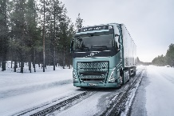
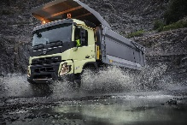
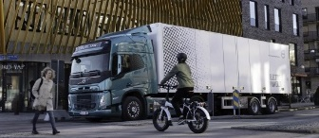
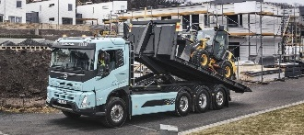
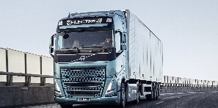
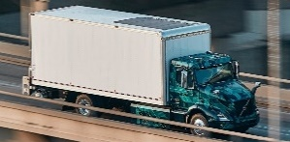
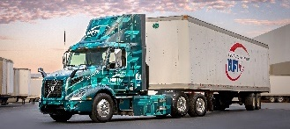
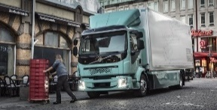
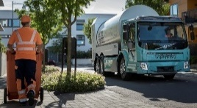
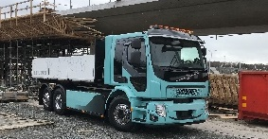
Electrification roadmap per transport segment
202X
FH, FM, FMX Electric
Europe + International
2022
Long Haul
Heavy Construction
Energy Efficiency
Vehicle Range
Charging Speed
Total Cost of Ownership
Load Capacity
Markets
Segments
Applications
FH, FM, FMX Electric
Europe
2020
Regional Distribution
Urban Construction
Regional Haul
VNR Electric
North America
2019
Local Distribution
Regional Transports
FL & FE Electric
Europe
City Distribution
Refuse Collection
Light Construction

Slide 10
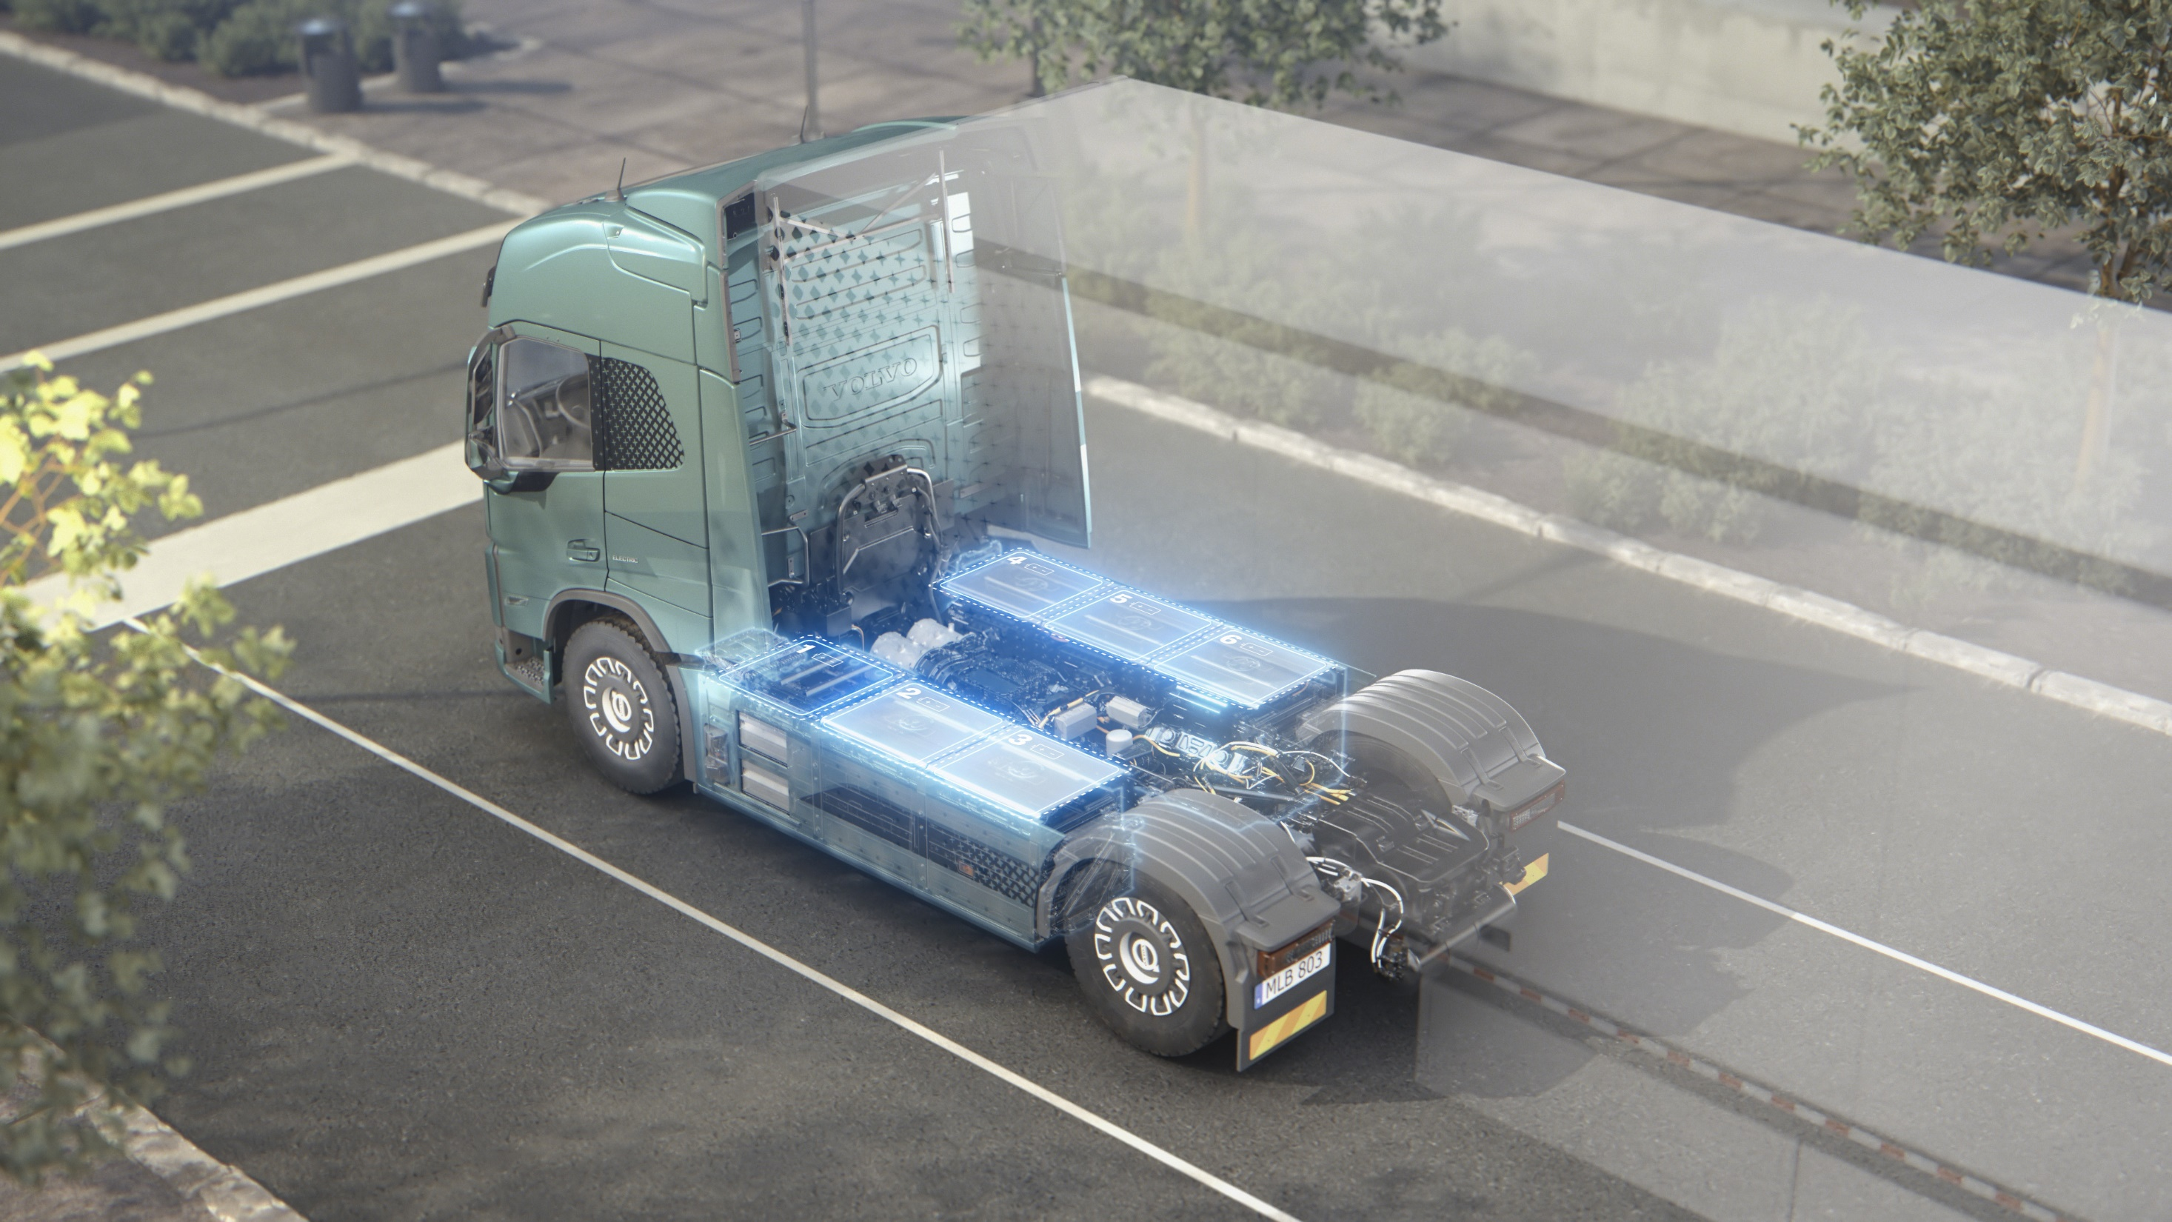
Volvo FH / FM / FMX Electric – now in production!
Driveline Power: 490 kW
Energy capacity: 540 kWh
Charging power AC/DC: 43 kW / 250 kW
Combination Weights up to 44 tones
Driving Range up to 300 km
Volvo Trucks

Slide 11
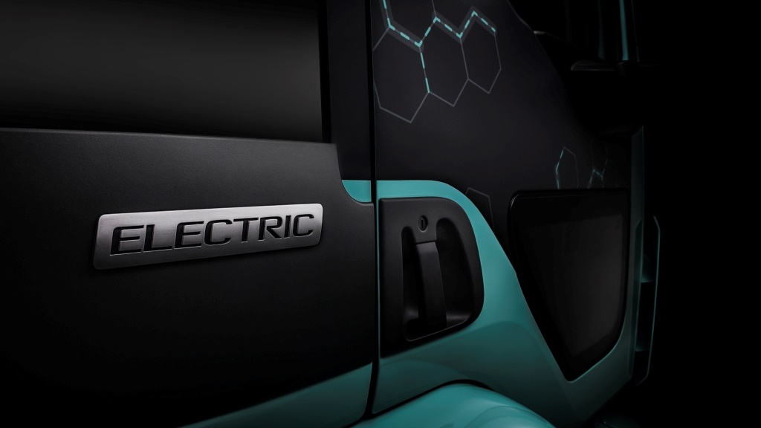
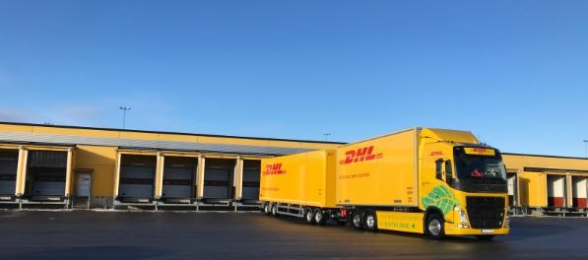
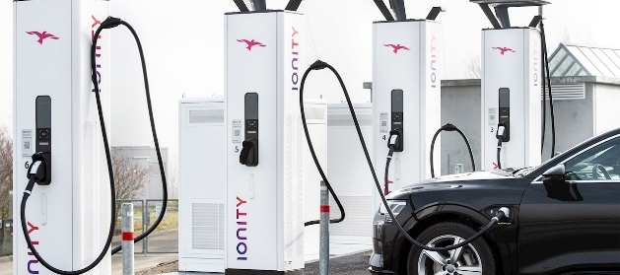
Truck Charging Options
Private
Vehicle dedicated charger
At vehicle ”home” base
Charging over night
8h+
20-100kW
Restricted Public
Shared charging HW
At customer premises
During loading/unloading, change of driver etc.
1-3h
150kW+
Public
Shared charging HW
At public locations
During non-charging related standstill
0,5-1,5h and 8h+
350kW+ and 20-100kW
Volvo Trucks

Slide 12
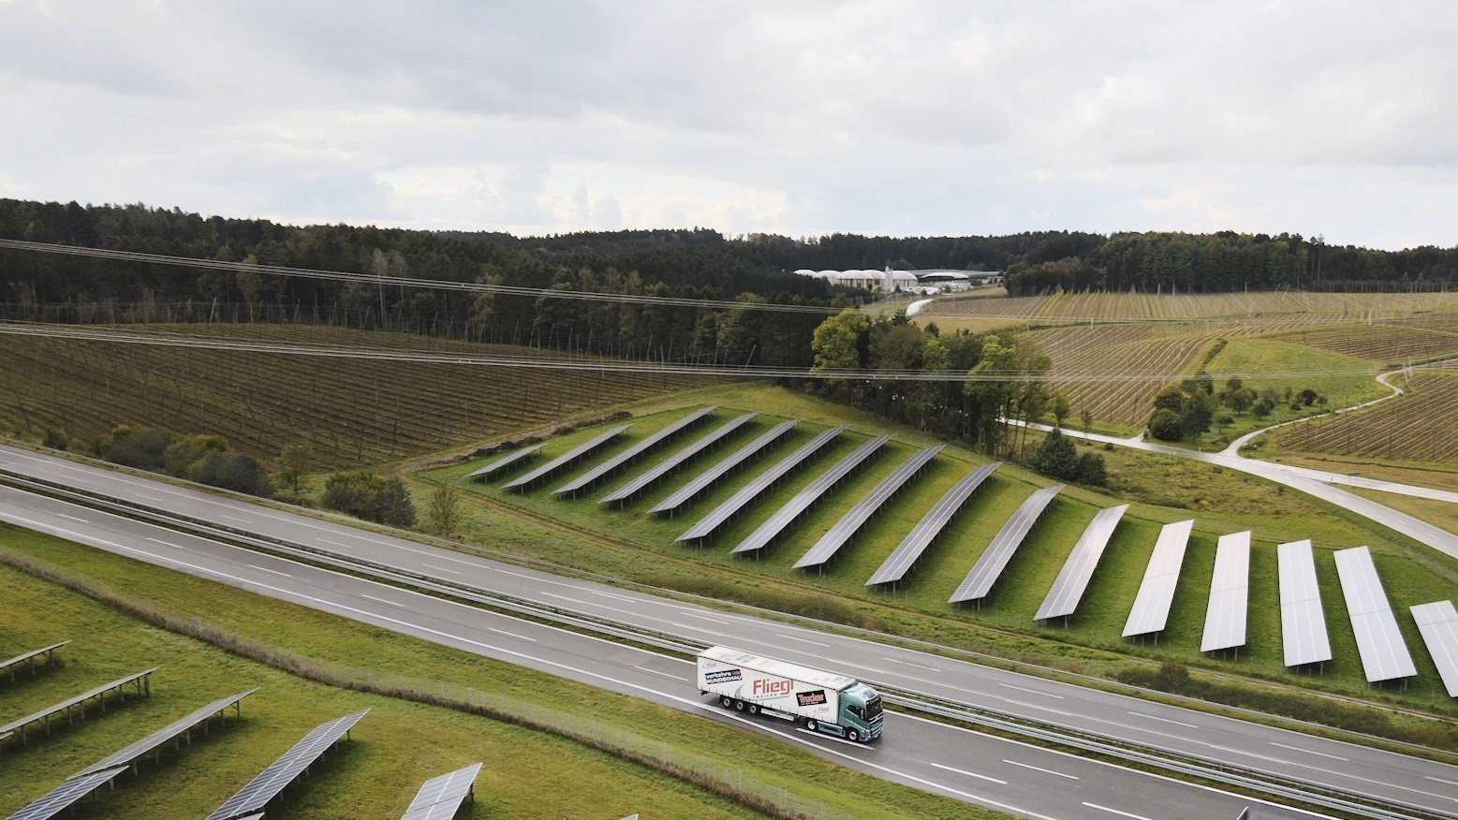
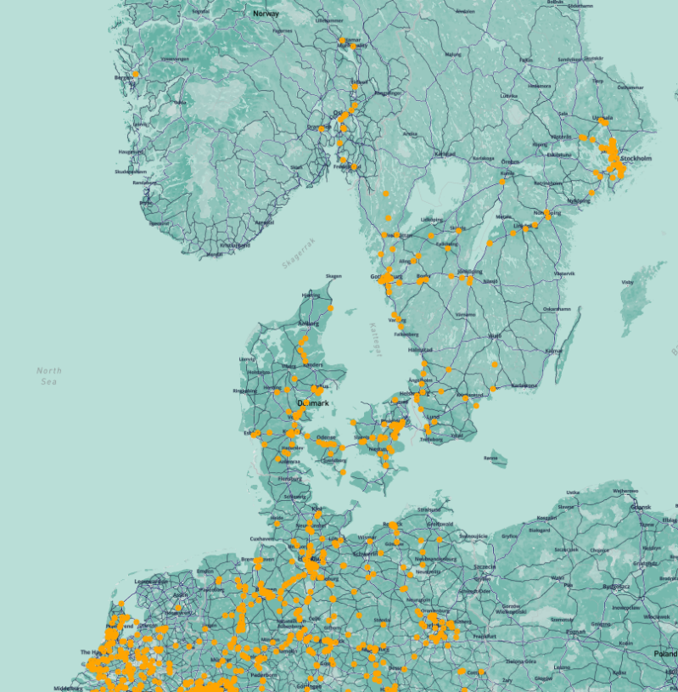
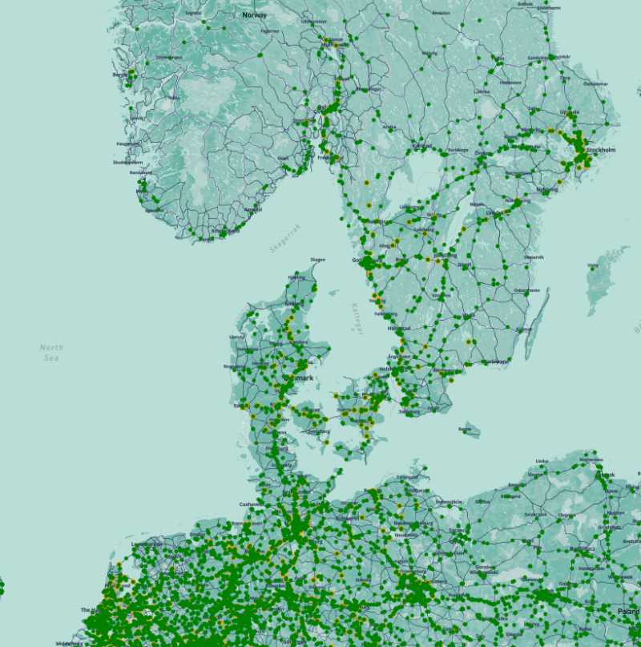
Potential shared charging locations for trucks in regional applications
Step 1: Regional Operations
Step 2: General Operations
Based on real movement data from 100k+ diesel vehicles from ACEA members (all major heavy duty OEMs)
Both restricted public and public
Provide a first estimate on logistically optimal locations for recharging vehicles
Stop locations for regional and general operation cases correlate very well
Volvo Trucks
ACEA: Interactive map – Electric trucks: regional stop locations fit for charging point deployment in Europe

Slide 13
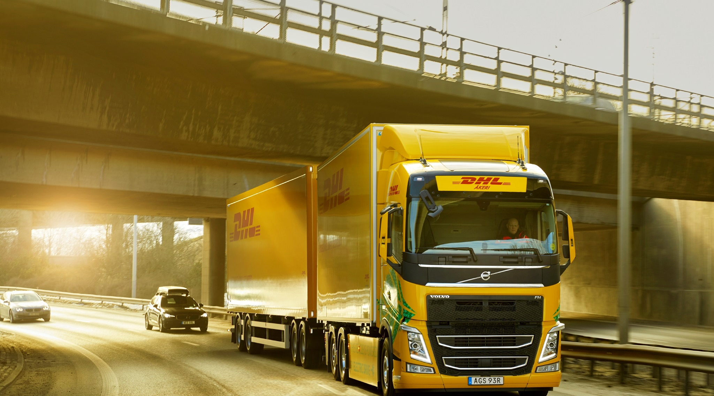
Win, win, win – Smarter and more efficient transport systems helps to make a bigger difference
76 T
3 trucks / 294 m
20-30% Efficiency
Reduced congestion
Increased Safety
60 T
4 trucks / 364 m
40 T
6 trucks / 492 m
200 EU pallet
120 tonnes
Volvo Trucks

Slide 14
Thank you!

