Slide 1




RC Update & 2024 KPIs
Sponsors and Media Partners:

Slide 2

https://sustainability.coldplay.com/

Slide 3
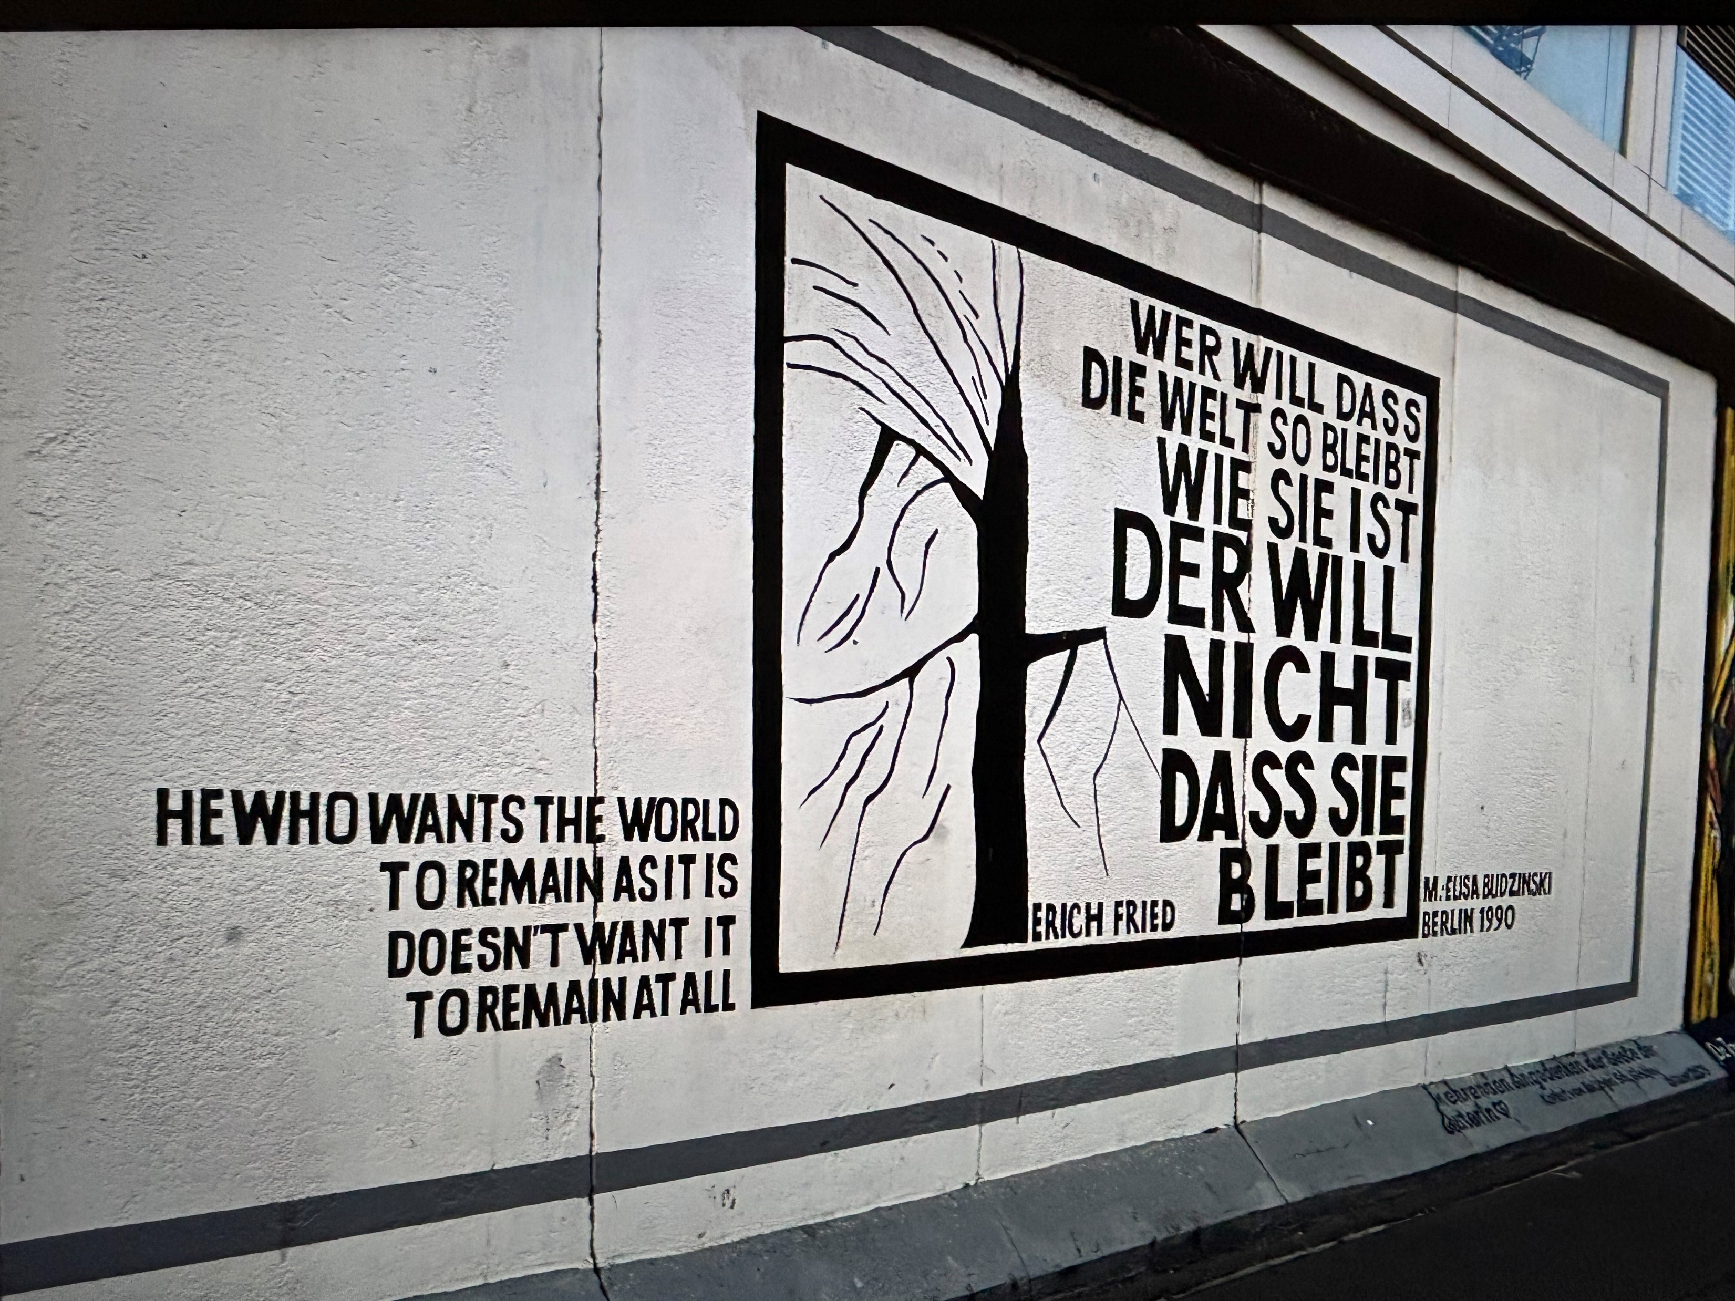
Sponsors and Media Partners:

Slide 4
KPI Results
64 member companies submitted KPIs on time
2 were late due to wrong contact details in our system
Less work needed in validating and correcting figures
Excellent performance compared to previous years

Slide 5
Activity
Tonnage delivered
Year | Mtonnes
2020 | 104
2021 | 96
2022 | 87
2023 | 80
2024 | 94.7
KMs driven | Orders delivered
Million KMs | 000 orders
2886 | 5256
2717 | 4036
2781 | 3803
2354 | 3534
2498 | 4282
Reasons for growth ;
Business consolidation & acquisitions in transport
More ECTA members
Additional fuels transport
Sponsors and Media Partners:

Slide 6
Intermodal Shift
Shift to Intermodal
Year | % Road | % Inter
2020 | 49.5 | 50.5
2021 | 52.6 | 47.4
2022 | 53.1 | 46.9
2023 | 54.6 | 45.4
2024 | 58.0 | 42.0
Continued shift back to road – more pronounced in 2024
Sponsors and Media Partners:

Slide 7
Injuries
Injury incidents
Year | In Transit | Loading | Unloading
2020 | 44 | 43 | 89
2021 | 61 | 58 | 103
2022 | 58 | 47 | 94
2023 | 71 | 42 | 109
2024 | 85 | 46 | 127
Injury incidents
Year |  | In Transit (per M KMs) | Loading (per 1,000 orders) | Unloading (per 1,000 orders)
2022 |  | 0.021 | 0.012 | 0.024
2023 |  | 0.030 | 0.011 | 0.030
2024 |  | 0.034 | 0.011 | 0.030
 |  | 113% | 100% | 100%
Sponsors and Media Partners:

Slide 8
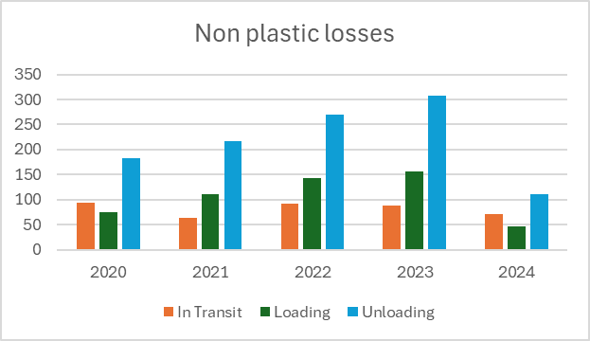
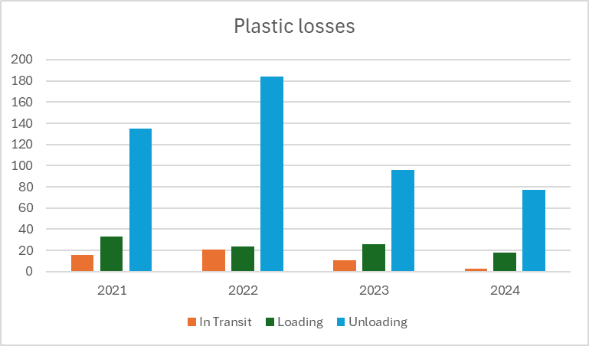
Product Loss
Non-Plastic losses
Year | In Transit | Loading | Unloading
2020 | 93 | 74 | 183
2021 | 63 | 110 | 216
2022 | 92 | 143 | 270
2023 | 88 | 156 | 307
2024 | 71 | 46 | 111
Plastic losses
Year | In Transit | Loading | Unloading
2021 | 16 | 33 | 135
2022 | 21 | 24 | 184
2023 | 11 | 26 | 96
2024 | 3 | 18 | 77
Plastic losses per million (dry bulk) KMs
Year | In Transit | Loading | Unloading
2023 | 0.010 | 0.025 | 0.091
2024 | 0.003 | 0.016 | 0.068
 | 30% | 64% | 75%
Sponsors and Media Partners:

Slide 9
In Transit Incidents
Damage ; >€20,000 regardless of whether chemical product contributed
Involvement of authorities ; Direct involvement of emergency services in the transport incident OR evacuation of persons OR closure of public traffic route for 3 hours or more caused by the incident
Minor RTC ; No injuries & damage <€10,000
Major RTC ; LTI to driver, any injury to third party OR damage >€10,000
Rollovers :
65% were baffled tanks
54% due to driving style/speed/braking
4% due to weather
27% have no root cause specified
RTC = Road Traffic Collision
LTI = Lost Time Injury

Slide 10
Fleet – Engine Types
Alt fuel includes ; LNG/CNG, Hydrogen, Electric, Hybrid
Sponsors and Media Partners:

Slide 11
Fleet – Fuel Types
Significant increase in the use of HVO
Sponsors and Media Partners:

Slide 12
Changes for 2025
Fuel split to be in % Litres rather than vehicles
Emission calculation questions to align with SQAS
No need for emission reduction initiatives
Sponsors and Media Partners:

Slide 13


Webinar Update
February
October
November
Requirements for completing the 2025 KPI Forms
Sponsors and Media Partners:

Slide 14
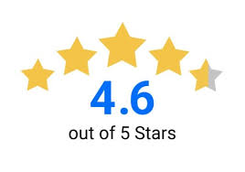

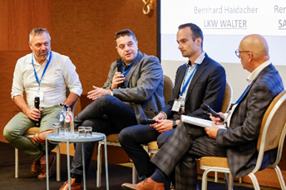
RC Workshop & Training
Training day was new
Two day event was a success
People were engaged and productive

Slide 15



Best Practice Guidelines
Published
Due by end of year
Sponsors and Media Partners:

Slide 16

…and finally
Sponsors and Media Partners:

Slide 17

Sponsors and Media Partners:

Slide 18


ECTA Digitalization Workgroup
ECTA VP digitalization: Joep Aerts
ECTA & ECLIC managing director: Peter Devos
How is ECTA supporting digitalization in chemical logistics?
Notes:
WG Started in 2019 and meanwhile we have 7 ECTA digital guidelines
Put the digital foundations in place :
Interoperability
Allow digital collaboration between actors
Foundation of structured data exchanges – replace free text fields
Speak the same digital language => standardization
Increase efficiency - ,reduce complexity
Improve sustainability and transparency

Slide 19

Gain competitiveness and resilience through “digital collaboration”
New ECTA-Cefic-ECLIC Digital collaboration survey 2025
Community and teams
People, skills with external company view
process Harmonization
End to end processes
Data standards and definitions
Common language and data models
Real time system connectivity
Systems connectivity & IT technology
Digital
collaboration
https://www.ecta.com/guidelines/
Data governance
Notes:
WorkGroup is not new and started in 2019 with digital best practice guidelines and the eECLIC eECD initiative. . ECTA’s Focus is on “digitalization” extra muros or oustide the 4 walls of a company and with external partners, collaboration between carriers, shippers, customers or partners along the transport and logistics chain. This can be to create visibility, to reduce the paper file or to avoid data “type over work” and to react faster to create resilience/competitveness.

Slide 20


ECTA Digital INTERMODAL standards UIRR- ERFA- ECTA Intermodal Digitalization WorkgrouP 2025
Notes:
WG Started in 2019 and meanwhile we have 7 ECTA digital guidelines
Put the digital foundations in place :
Interoperability
Allow digital collaboration between actors
Foundation of structured data exchanges – replace free text fields
Speak the same digital language => standardization
Increase efficiency - ,reduce complexity
Improve sustainability and transparency

Slide 21

3 new Digital Best Practice guidelines published in October 2025
Guideline 1:
General principles for a standardised digital data sharing in intermodal freight transport
Guideline 2:
Standardized Intermodal Digital Booking - Gate IN and Gate OUT
Guideline 3:
Standardized digital data sharing in intermodal freight between RU-CTO-TO
https://www.ecta.com/guidelines/
2026
Digital UIRR-ECTA webinars to explain, promote new guidelines

Slide 22
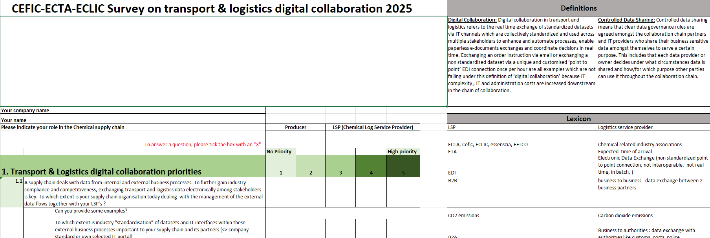
Cefic-ECTA-ECLIC digitalization survey
New digital collaboration Survey launched early November ‘25 together with Cefic
Open invite to share your thoughts, replies by end November
Results in 2026

Slide 23
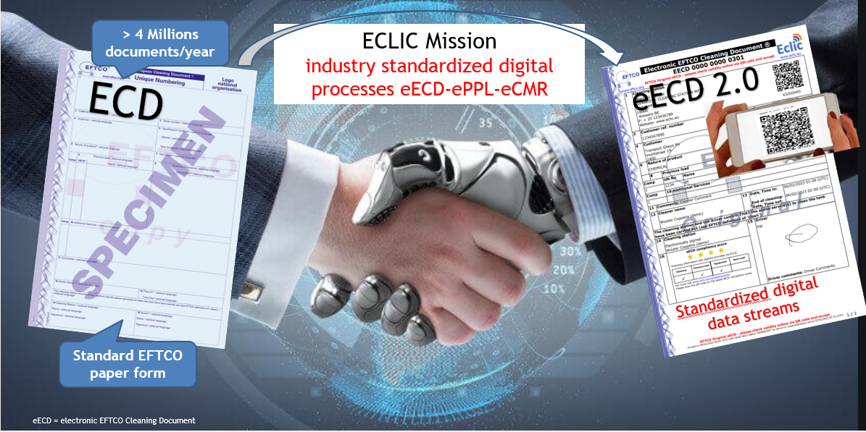
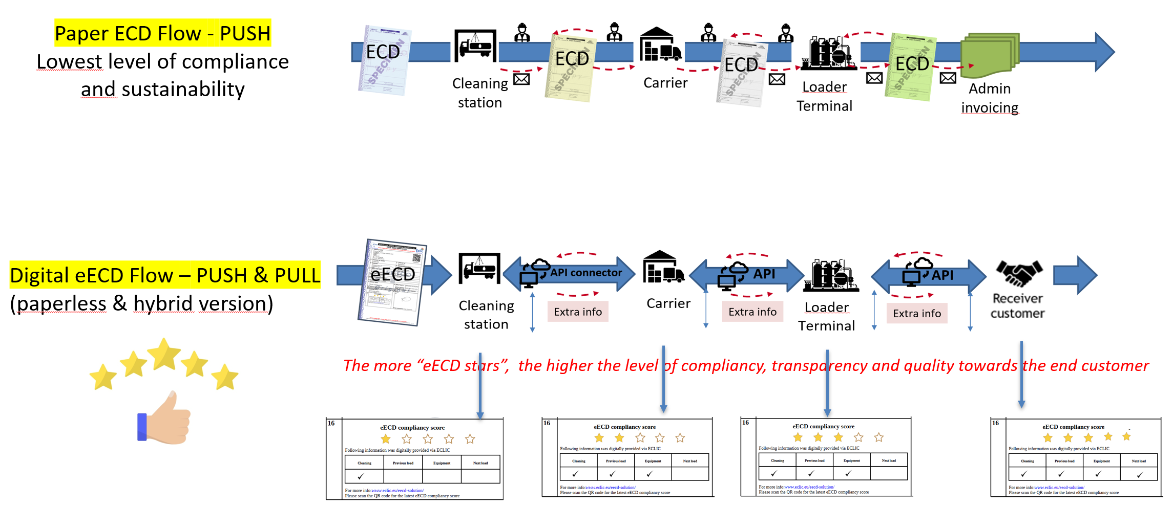
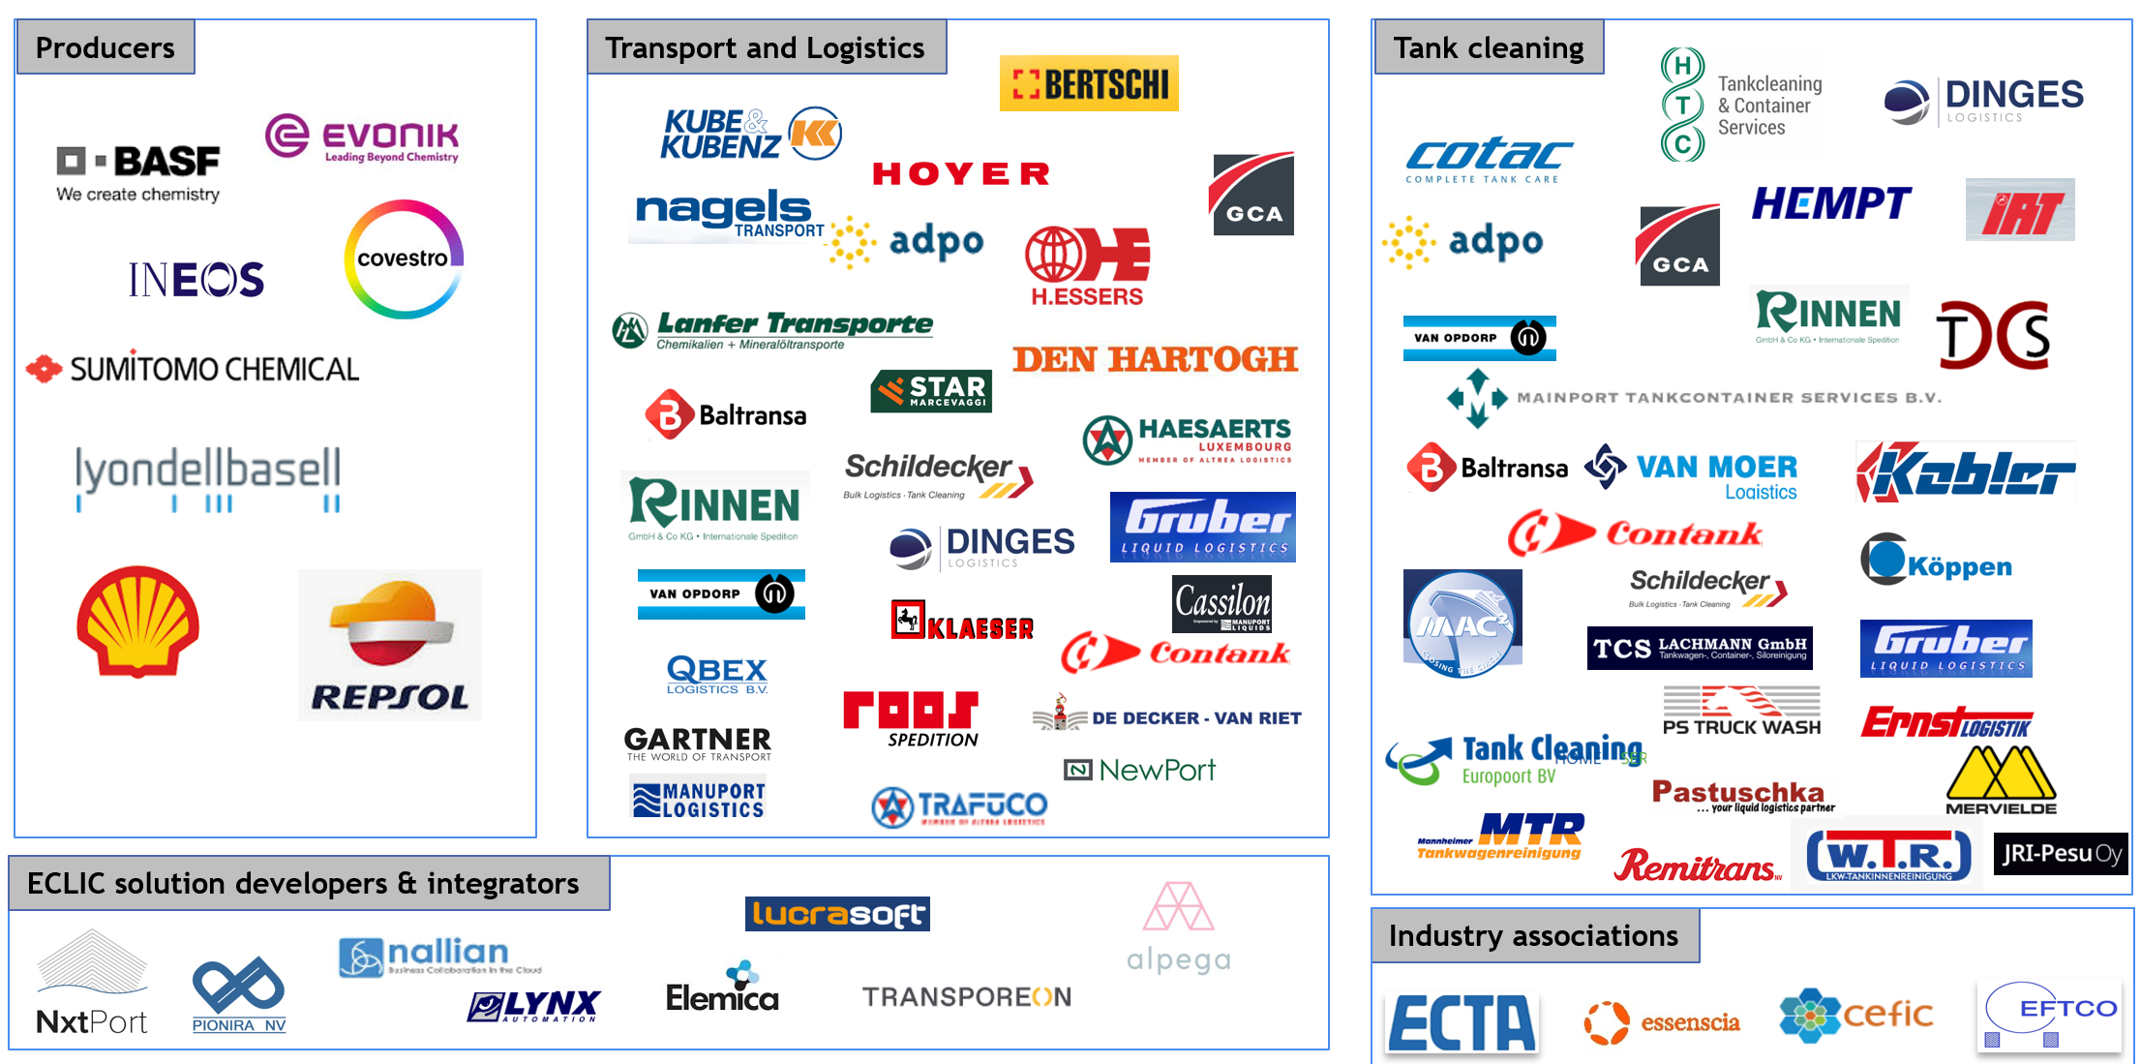
Digital Collaboration in tankcleaning via the ECLIC community
The electronic EFTCO Cleaning document
eECD Use Case (non competitive process)

Slide 24



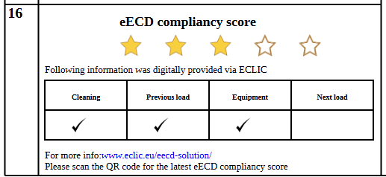



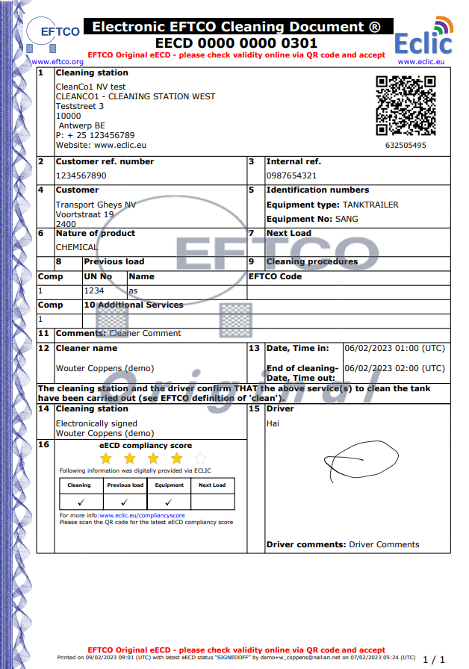


New integrated way of working in tankcleaning Move to an industry wide, circular, collective, digital eECD tank cleaning process to create value together
SDS
SDS
Carrier
Digital eECD Flow – PUSH & PULL
(paperless & hybrid version)
Extra info & value
Previous load
Extra info & value
Previous load
eECD
Cleaning
station
Loader-Producer
Terminal
ePPL
SDS
SDS
eECO
Extra info & value
Previous load
Extra info & value
Next Load
eEquip
Customer – Receiver

Slide 25
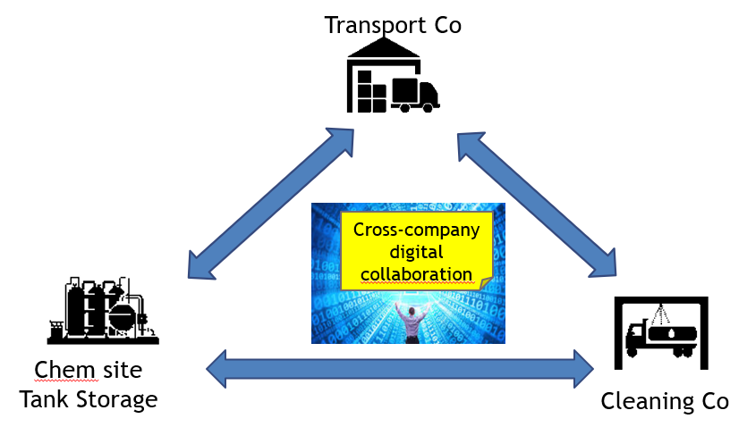


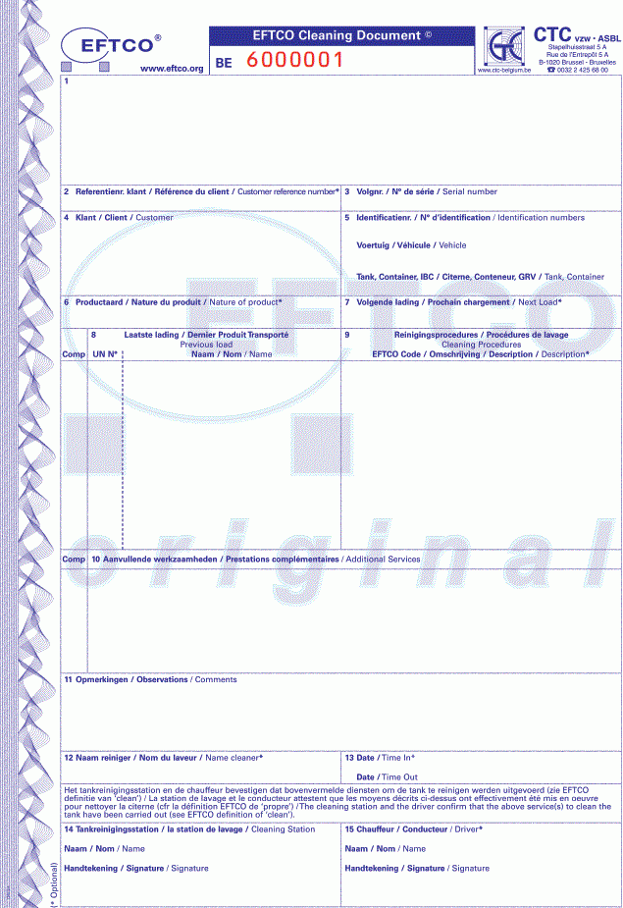

Digital eECD - EU Scale-Up going forward As of Sept 2025, electronic eECD document requirement is embedded in SQAS revision 2025
EU-CD
Paper ECD
100% Digital eECD
eECD digital industry standard by associations
2026-xxxx
(digital path forward
2005-2025 (paper based)
- Exceptional case - Cleaning Company has no SQAS in place yet -Awaiting to be SQAS assessed -EFTCO EU-CD form accessible, only temporarily granted | -Cleaning station is SQAS assessed + SQAS in place -EFTCO Paper ECD use granted | -Cleaning station approved by EFTCO to use digital eECD and EFTCO paper ECD Cleaning station is SQAS digitally assessed and ready
Cleaning
station
ECD = EFTCO Cleaning document
Notes:
Today, the paper ECD in 4-fold is still the norm and all SQAS assessed cleaning stations can issue such paper ECD document. In 2020 ECLIC, together with EFTCO, ECTA and essenscia launched the digital eECD version and demonstrated that the paper ECD can be replaced with a digital version as long as all parties involved work digitally together. As of 2023
, ECLIC enhanced it’s digital eECD process with a uniform European QR code design so that coexistence of paper & digital eECD’s is feasible for a limited period and not later than 2028. For EFTCO it is preferred to keep this transition period as short as possible because operating both the paper and digital process, is not very effective and keeps the status quo.
With this slide, ECTA asks all actors -cleaning stations, carriers and shippers to prepare themselves. For that purpose, also SQAS digitalization questions are part of the SQAS revision 2025. These questions were already in the PAD SQAS section because also shippers need to prepare themselves to accept documents digitally and digital collaboration can only happen if it’s done by all parties in an interoperable and synchronized way.

Slide 26
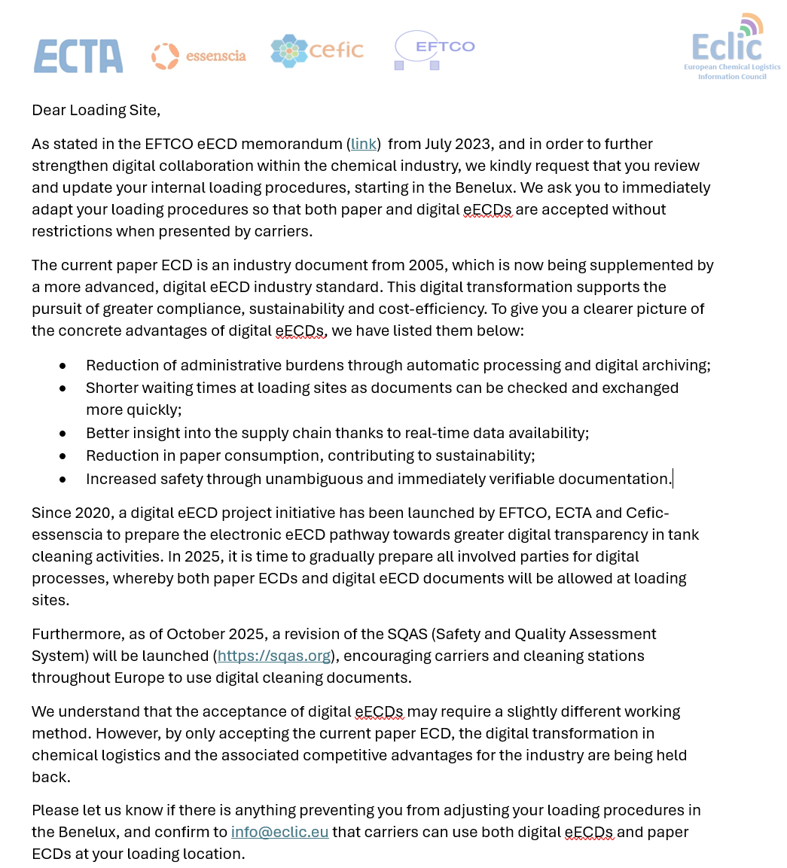
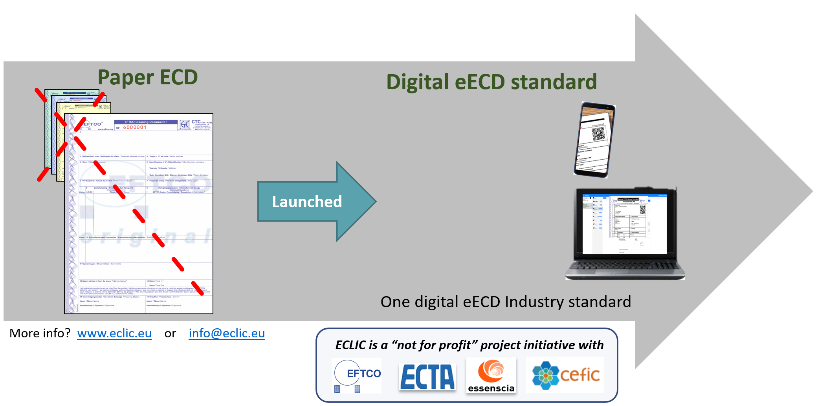
eECD roll out in 2025 – 2026
100% eECD digital switch at 2 cleaning stations in Belgium
Acceptance by non licenced carriers and loading places
eECD-ePPL roll out plans in Germany
eECD-ePPL roll out plans in Netherlands
eECD-ePPL roll out plans in Spain
eECD-ePPL roll out plans in France
Investigate eECD for food (2026)
Explore eCMR synergies – align with eFTI (‘26-’29)

Slide 27

eFTI Regulation eFTI4Chem Use Case 2026-2029
Purpose of the eFTI regulation: The eFTI Regulation aims to digitize and harmonize the exchange of regulatory freight transport information across all EU Member States, covering road, rail, inland waterway, and air transport. It is intended to move the sector from paper-based to fully electronic documentation
eFTI Implementation Timeline
August 2024: Regulation applies (from 21 August 2024).
January 2025: IT system development by Member States begins.
September 2025: EU adopts final technical specifications.
January 2026: Preparations for operational use & certification.
July 2027: eFTI fully applicable; authorities must accept data (digital eCMR/eCIM/eDGD,…) from certified platforms; all systems must be aligned.

Slide 28
eFTI4chem digitalization consortium 2026
Demonstrate eFTI regulation in practice through an eFT4chem Use Case while fulfilling the legal eFTI requirements (2026-2029)
Specific eFTI focus on Chemical Dangerous goods and waste shipment flows
Prepare and submit the eFTI4chem Use case to obtain EU funds (by Jan 2026)
Ensure industry associations involvement (IRU-ECTA-UIRR-ECLIC-Cefic) to maximize eFTI interoperability and share learnings
Include road, rail, maritime and inland waterways transport modes in eFTI4chem Use case scope

Slide 29


WOMEN IN LOGISTICS
Improve Male Female Balance
in Chemical Logistics
- Logistics Leadership
- Truck Drivers
- Logistics Operators
Homepage - Women In Logistics

Slide 30













WIL Board meeting participants
Co-chairs 2024-2025 (rotational approach):
Ania Haddaoui, DOW
Bob Van Steenweghen, H.Essers
WIL office Team: Laura Peymen (H.Essers)
Sector associations:
Peter Devos, ECTA
Joost Naessens (+ Vicky Charitaki), CEFIC
Board members:
Damla Alisan, PSA/Alisan
Sofie Wallyn, IFF
Stephanie Muhs, Hoyer
Joep Aerts, Den Hartogh Logistics
Hans-Joerg Bertschi, Bertschi
Doerte Lorenz, LyondellBasell
Emma Jonsson, ExxonMobil
Korneel Melkebeke, Eastman
Advisory board
BOARD

Slide 31




Sector challenge
WIL’S MISSION:
DRIVE MALE-FEMALE BALANCE
IN EU CHEMICAL LOGISTICS
Logistics has traditionally been a male-dominated industry
Attracting more women to the logistics sector can address critical business challenges, such as labor shortages and European competitiveness.
The economic impact of achieving a better male-female balance is immense.

Slide 32



A unique approach
Women in Logistics is an unprecedented collaboration bringing together leading chemical producers, chemical logistics service providers, as well as key sector associations like ECTA and Cefic.
To provide a concrete roadmap for our endeavors, Women in Logistics has chosen to concentrate efforts on three key target groups:
drivers
operators
leadership

Slide 33
Join us today
Become member and
join us in driving the change!
FILL IN YOUR
MEMBERSHIP APPLICATION
HERE!

Slide 34






























WIL MEMBERSHIP APPLICANTS
WIL BOARD MEMBERS
Notes:
AnnLee staat er niet op, dit is een BV zonder logo

Slide 35
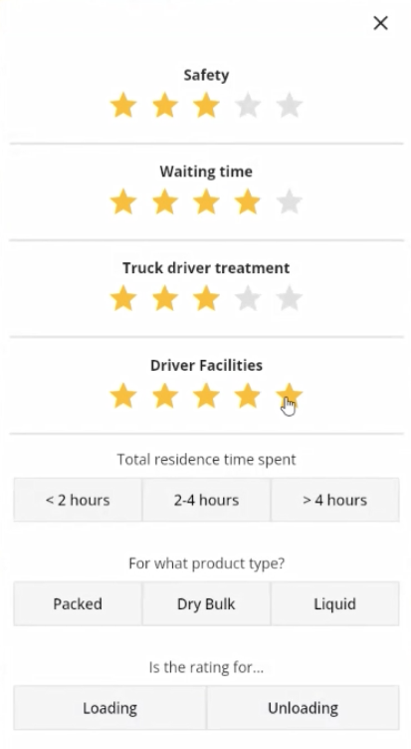
Ecta drivers app
Sponsors and Media Partners:

Slide 36


Ecta drivers app
2000 Drivers
1300+ Locations to rate
One third+ of the
ECTA Members use it already

Slide 37
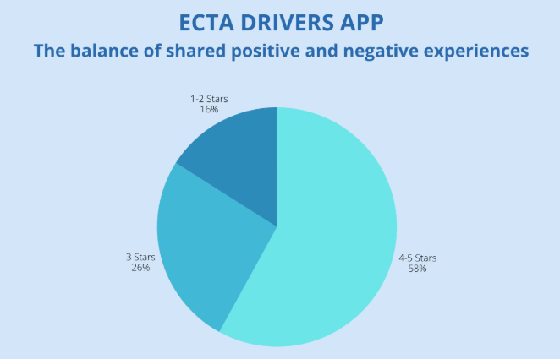
Truck drivers give fair ratings and mostly positive

Slide 38
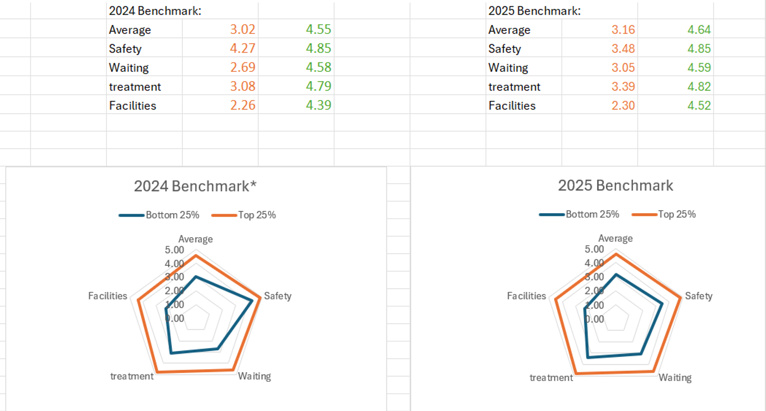
ECTA Drivers APP – interim results 2024- 2025 YTD
Bottom 25% Top 25%
Bottom 25% Top 25%

Slide 39
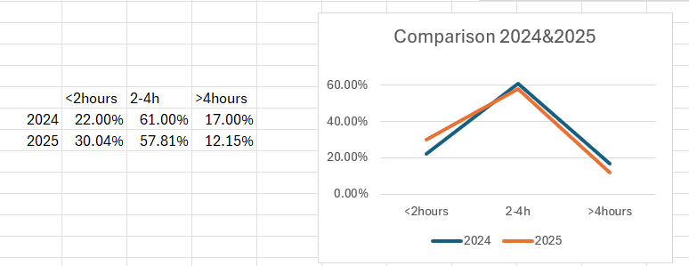
ECTA Drivers APP
-
Interim benchmark results 2024 & 2025 YTD – Total residence time
Decrease in 4+h residence time and increase in <2h residence time → good development
39

Slide 40
ECTA Drivers APP
-
Survey learnings – steps forward
Communication:
Communication loops about improvements are key for drivers
Improvements-Change
Shippers are asked to improve based on reviews to make drivers believe in tool – joint effort, no excuses
Engagement:
Drivers are happy to share their opinions provided they do see change at (un)loading places
40

Slide 41





ECTA Driver Wellbeing Awards 2025 the winners:
Vita Cellular Foams Ltd Manchester
LBC Rotterdam BV
BASF Espanola SL Barcelona
Advario Stolthaven Antwerp
BASF Antwerp Gate 6
Arkema Carling
Leuna Tor 1

Slide 42
Q&A
Sponsors and Media Partners:

